Slide 1

Fundamentals of Machine Learning

Slide 2
Outline
Data paradigms and dimensionality reduction
Basic concept of loss function and optimization in machine learning
Basic concept of probability formulation and parametric/non-parametric density estimation in machine learning
Basic concept of linear and logistic regression
Supervised and unsupervised learning
Evaluation metrics for assessing a machine learning solution

Slide 3
Pillars of ML
Regression
Dimensionality
Reduction
Density
Estimation
Classification
Vector Calculus
Linear Algebra
Probability and
Analytical
Geometry
Optimization
Matrix
Decomposition

Slide 4
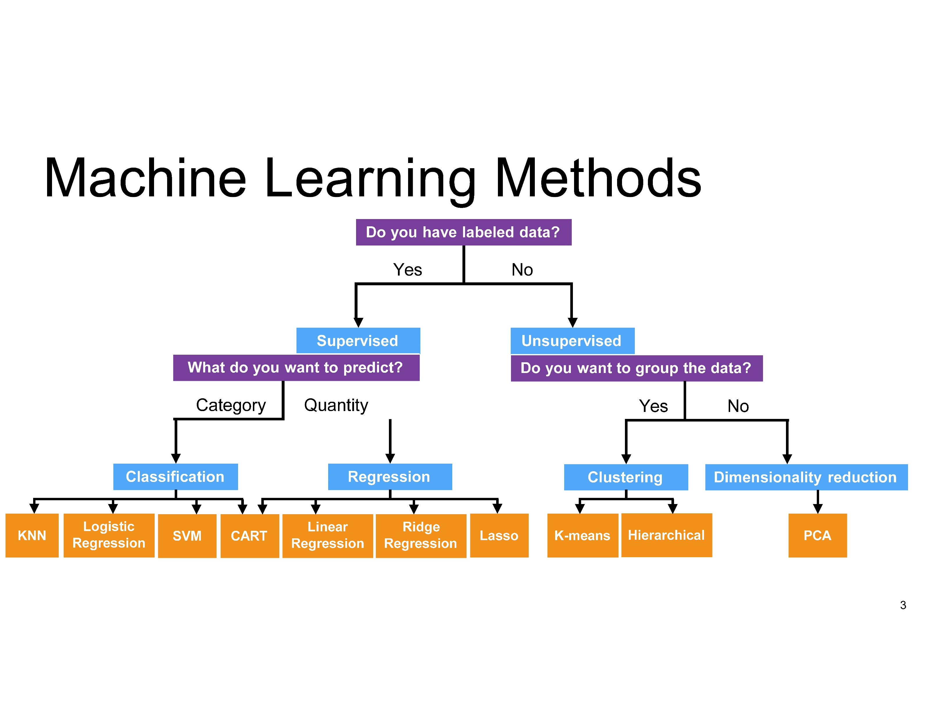

Slide 5
What is Data?
We’ll define data as a collection of examples, and their features.
example
Age | Job? | City | Rating | Income
23 | Yes | X | A | 22,000.00
23 | Yes | Y | BBB | 21,000.00
22 | No | Z | CC | 0.00
25 | Yes | W | AAA | 57,000.00
19 | No | XX | BB | 13,500.00
22 | Yes | YY | A | 20,000.00
21 | Yes | WW | A | 18,000.00
19 | No | XYZ | C | 29,000.00
feature
Each row is an “example”, each column is a “feature”.
We can also call examples “samples”.

Slide 6
Types of Data
Numerical features come from ordered sets
Counts like age in {0, 1, 2, 3,…}
Ordinal like ratings in {best (1), good (2) neutral (3), bad (4), worst (5)}
Continuous/real-valued like height in {173.5, 162.4, 190.2,…}
Categorical features come from an unordered set:
Binary: job? {yes, no} or {1,0}
Nominal: city. {Chicago, Los Angeles, Dallas}
We need to consider how to convert categorical into numerical features.
We can perform 1 of N encoding for the cities and 0 and 1 for jobs (let’s ignore the rating)

Slide 7
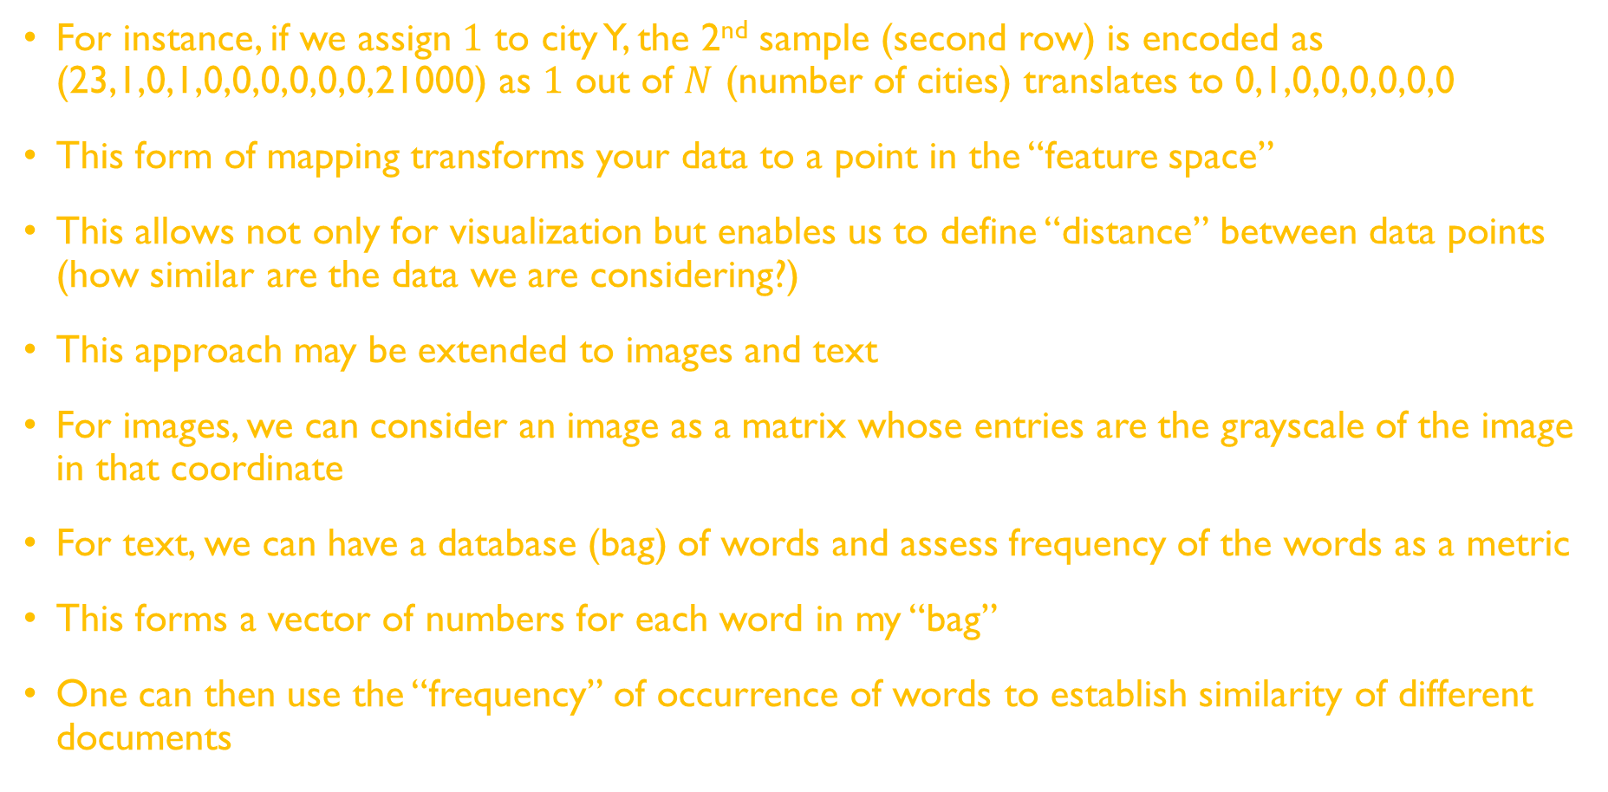
For instance, if we assign $1$ to city Y, the 2nd sample (second row) is encoded as (23,1,0,1,0,0,0,0,0,0,21000) as $1$ out of $N$ (number of cities) translates to 0,1,0,0,0,0,0,0
This form of mapping transforms your data to a point in the “feature space”
This allows not only for visualization but enables us to define “distance” between data points (how similar are the data we are considering?)
This approach may be extended to images and text
For images, we can consider an image as a matrix whose entries are the grayscale of the image in that coordinate
For text, we can have a database (bag) of words and assess frequency of the words as a metric
This forms a vector of numbers for each word in my “bag”
One can then use the “frequency” of occurrence of words to establish similarity of different documents

Slide 8
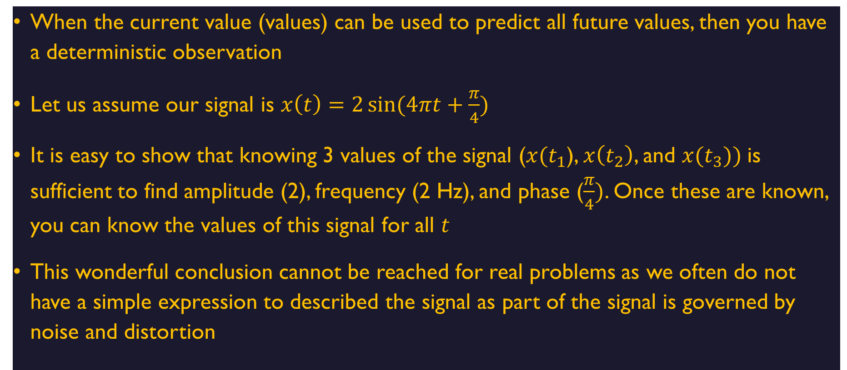
Data (deterministic)
When the current value (values) can be used to predict all future values, then you have a deterministic observation
Let us assume our signal is $x\left(t\right)=2\sin{(4πt+\frac{π}{4})}$
It is easy to show that knowing 3 values of the signal ($x(t_{1}$), $x\left(t_{2}\right)$, and $x(t_{3}))$is sufficient to find amplitude (2), frequency (2 Hz), and phase ($\frac{π}{4})$. Once these are known, you can know the values of this signal for all $t$
This wonderful conclusion cannot be reached for real problems as we often do not have a simple expression to described the signal as part of the signal is governed by noise and distortion

Slide 9
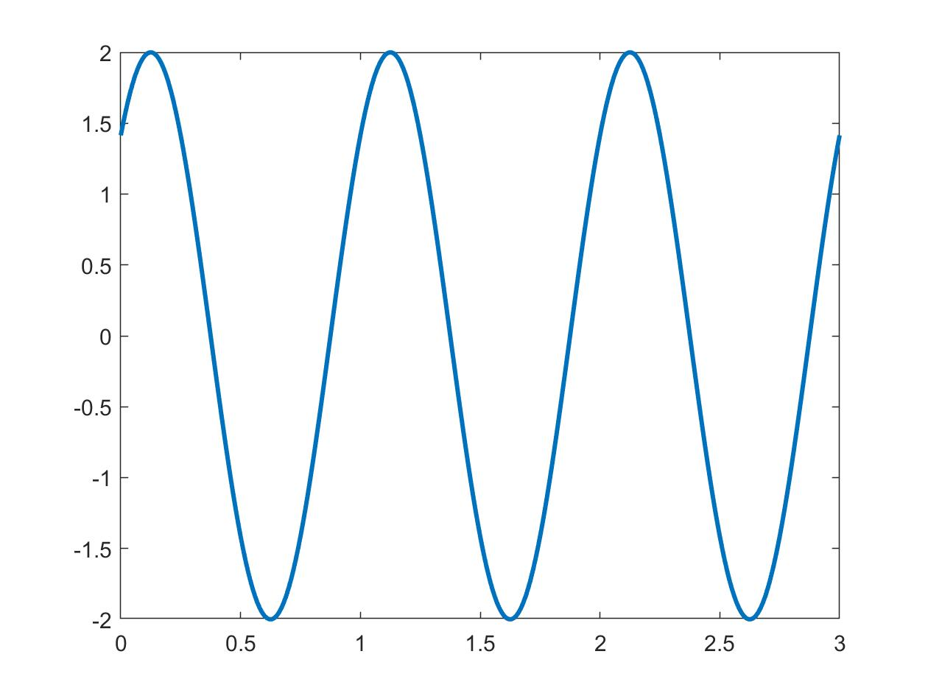



Data (deterministic)

Slide 10
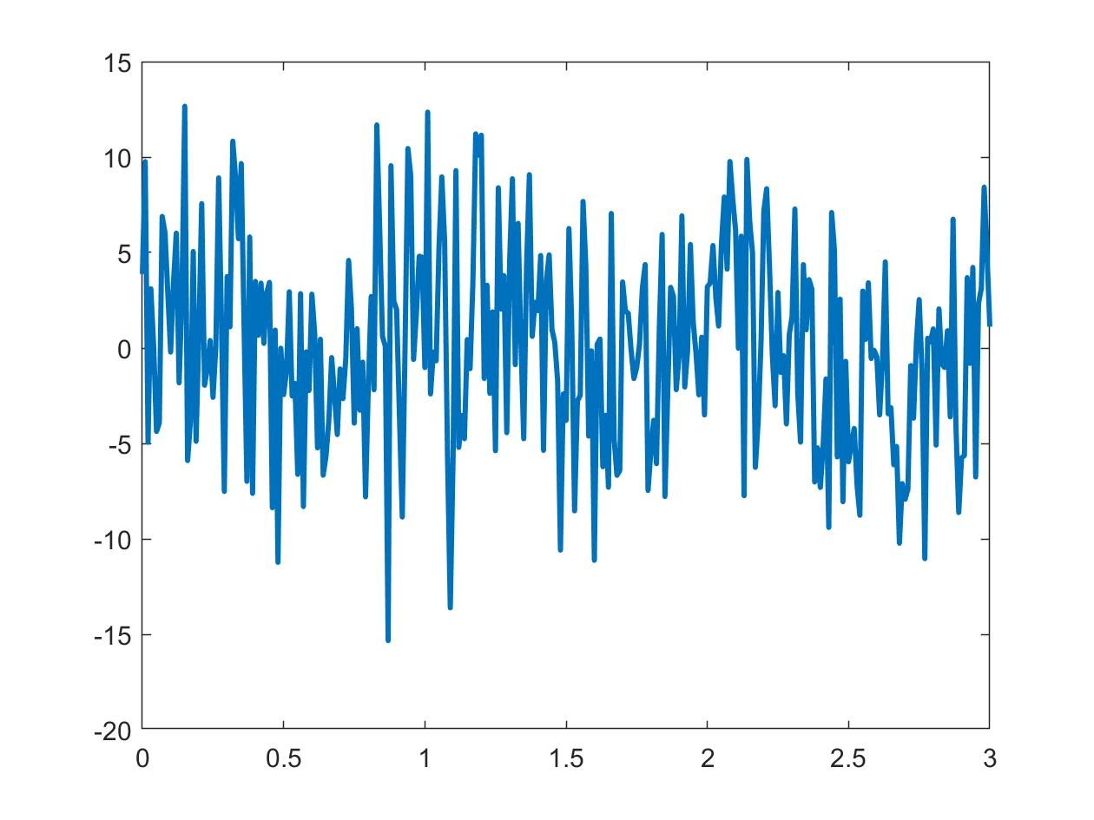
Data (real world)

Slide 11
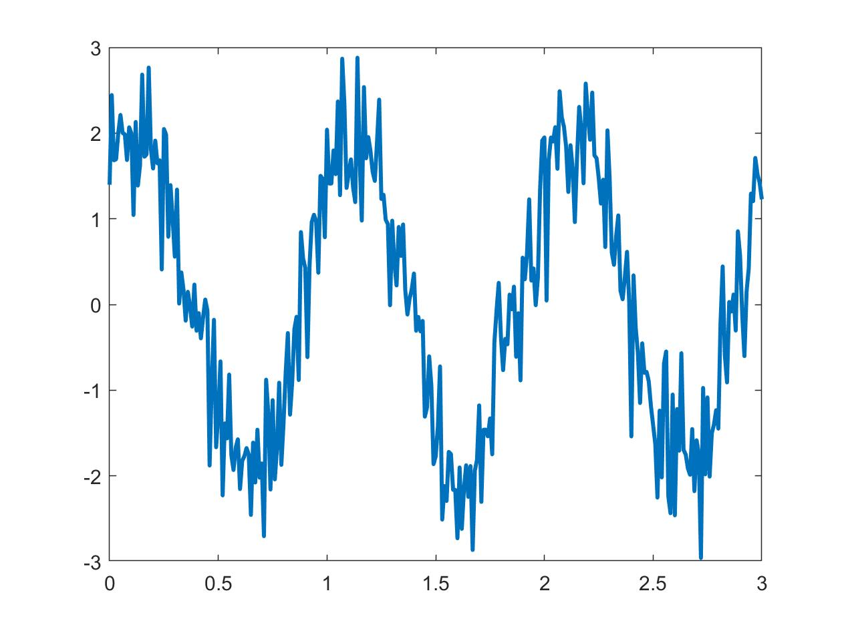
Data (real world)

Slide 12
Statistics
Data: [0 1 2 3 4 5 5 5 7 8 9 10 140 14 15 16]
Measures of location:
Mean(Data) = 15.5
Mode(Data) = 5
Median(Data) = 6
Quantile(Data,0.5) = 6
Quantile(Data,0.25) = 3.5
Quantile(Data,0.8) = 14.3
Measures of spread:
Range(Data) = [0 140]
Std(Data) = 33.6
IQR(Data,0.25,0.8) = 10.8
Notice that mean and std are impacted (adversely) by extreme values (“outliers”).

Slide 13
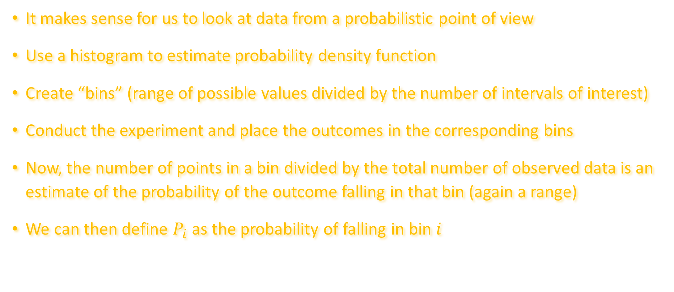
More statistics
It makes sense for us to look at data from a probabilistic point of view
Use a histogram to estimate probability density function
Create “bins” (range of possible values divided by the number of intervals of interest)
Conduct the experiment and place the outcomes in the corresponding bins
Now, the number of points in a bin divided by the total number of observed data is an estimate of the probability of the outcome falling in that bin (again a range)
We can then define $P_{i}$ as the probability of falling in bin $i$

Slide 14
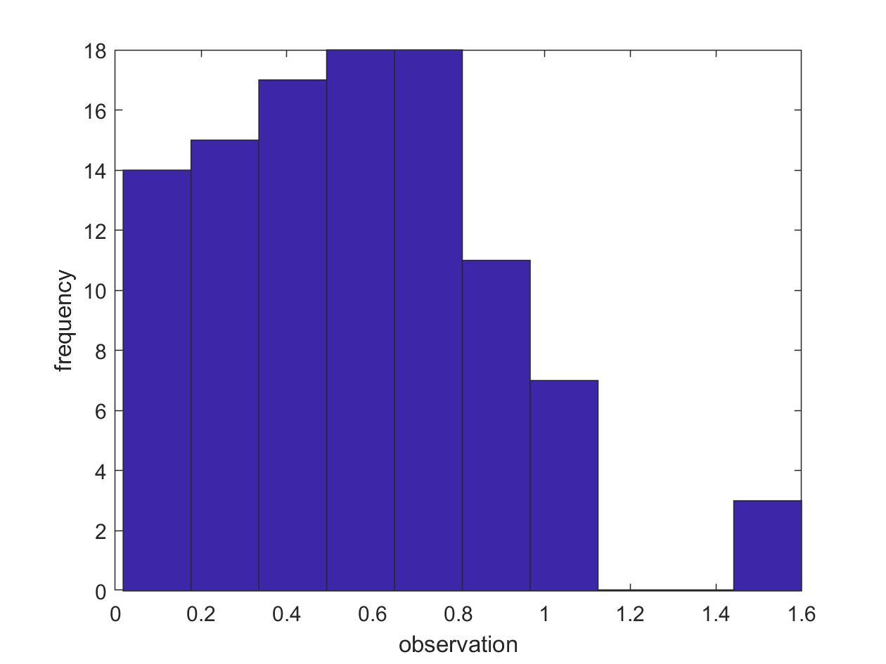










Slide 15
More statistics
One critical aspect of ML is to identify the underlying pdf of the data
If the pdf is known but its parameters are unknow, the problem is called parametric density estimation.
For instance, if we know a priori that we are dealing with a Gaussian pdf, all we need to do is to estimate the mean and the variance to fully characterize the density
For many problems, this is not true (the example above)
In that event, we need to resort to non-parametric density estimation (this will be discussed in later sections of this module)

Slide 16
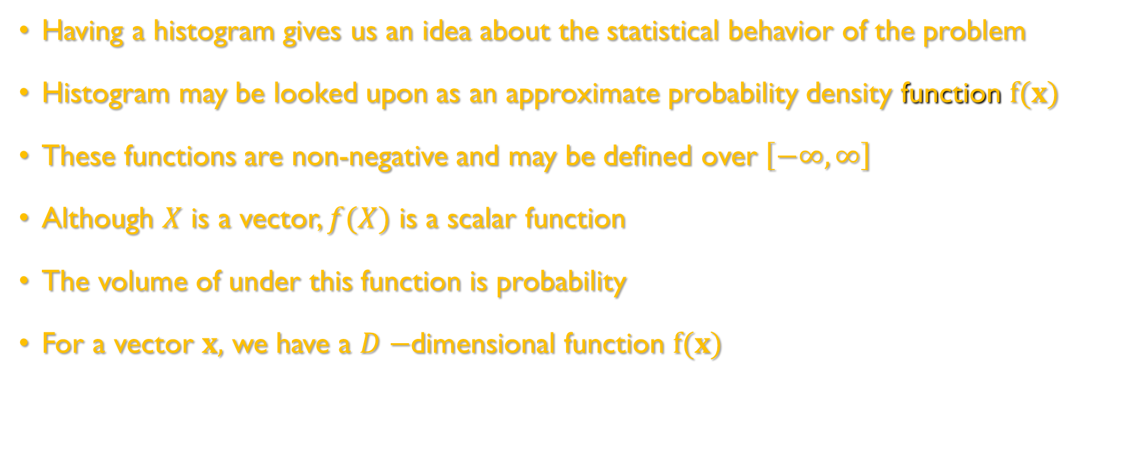
Measures of randomness
Having a histogram gives us an idea about the statistical behavior of the problem
Histogram may be looked upon as an approximate probability density function $f(x)$
These functions are non-negative and may be defined over $\left[−∞,∞\right]$
Although $X$ is a vector, $f(X)$ is a scalar function
The volume of under this function is probability
For a vector $x,$ we have a $D−$dimensional function $f(x)$

Slide 17
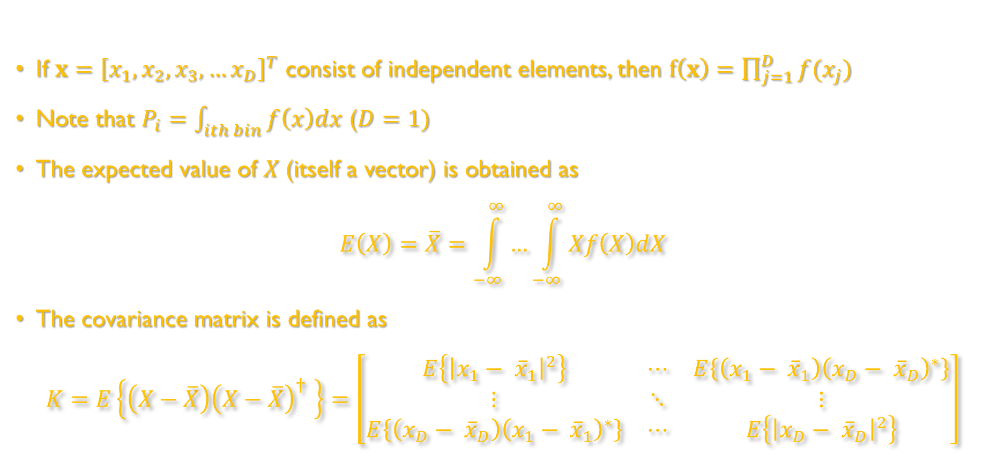

Measures of randomness
If $x={\left[x_{1},x_{2},x_{3},…x_{D}\right]}^{T}$ consist of independent elements, then $f\left(x\right)=\prod_{j=1}^{D}{f(x_{j})}$
Note that $P_{i}=\int_{ith bin}{f\left(x\right)dx}$ ($D=1)$
The expected value of $X$(itself a vector) is obtained as
$$E\left(X\right)=\overline{X}=\int_{−∞}^{∞}{…\int_{−∞}^{∞}{Xf\left(X\right)dX}}$$
The covariance matrix is defined as
$$K=E\left\{\left(X−\overline{X}\right){\left(X−\overline{X}\right)}^{†} \right\}=\left[\begin{matrix}E\left\{{\left|x_{1}− {\overline{x}}_{1}\right|}^{2}\right\} & ⋯ & E\left\{\left(x_{1}− {\overline{x}}_{1}\right){\left(x_{D}− {\overline{x}}_{D}\right)}^{∗}\right\} \\ ⋮ & ⋱ & ⋮ \\ E\left\{\left(x_{D}− {\overline{x}}_{D}\right){\left(x_{1}− {\overline{x}}_{1}\right)}^{∗}\right\} & ⋯ & E\left\{{\left|x_{D}− {\overline{x}}_{D}\right|}^{2}\right\}\end{matrix}\right]$$
D fold

Slide 18
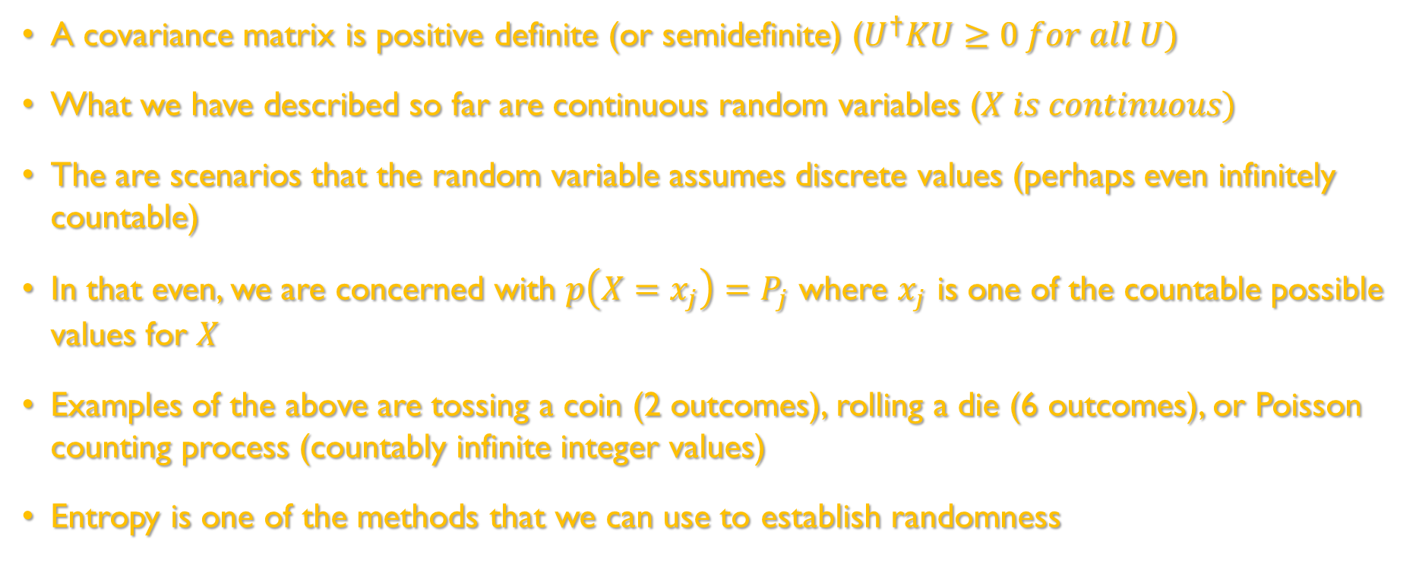
Measures of randomness
A covariance matrix is positive definite (or semidefinite) ($U^{†}KU≥0 for all U)$
What we have described so far are continuous random variables ($X is continuous)$
The are scenarios that the random variable assumes discrete values (perhaps even infinitely countable)
In that even, we are concerned with $p\left(X=x_{j}\right)=P_{j}$ where $x_{j}$ is one of the countable possible values for $X$
Examples of the above are tossing a coin (2 outcomes), rolling a die (6 outcomes), or Poisson counting process (countably infinite integer values)
Entropy is one of the methods that we can use to establish randomness

Slide 19
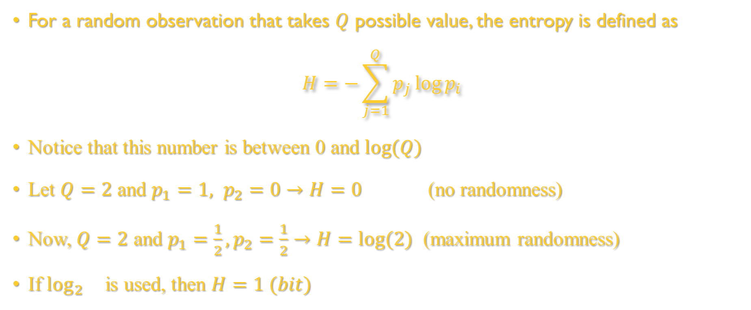
Measures of randomness-Entropy
For a random observation that takes $Q$ possible value, the entropy is defined as
$$H=−\sum_{j=1}^{Q}{p_{j}\log{p_{i}}}$$
Notice that this number is between 0 and $\log{(Q)}$
Let $Q=2$ and $p_{1}=1, p_{2}=0→H=0$ (no randomness)
Now, $Q=2$ and $p_{1}=\frac{1}{2}, p_{2}=\frac{1}{2}→H=log⁡(2)$ (maximum randomness)
If $\log_{2}{}$is used, then $H=1 (bit)$

Slide 20
Does our data need cleaning?
In general, the answer is “yes.”
What are the reason data is corrupted which may lead to problems with our analysis
Noise
Missing values that is needed for the problem at hand
Outliers (various reasons including data entry errors)
Duplicate data (repetition that does not add to our knowledge)
Some ML methods are immune to these
Interestingly, ML techniques are often best to detect and fix these issues!

Slide 21
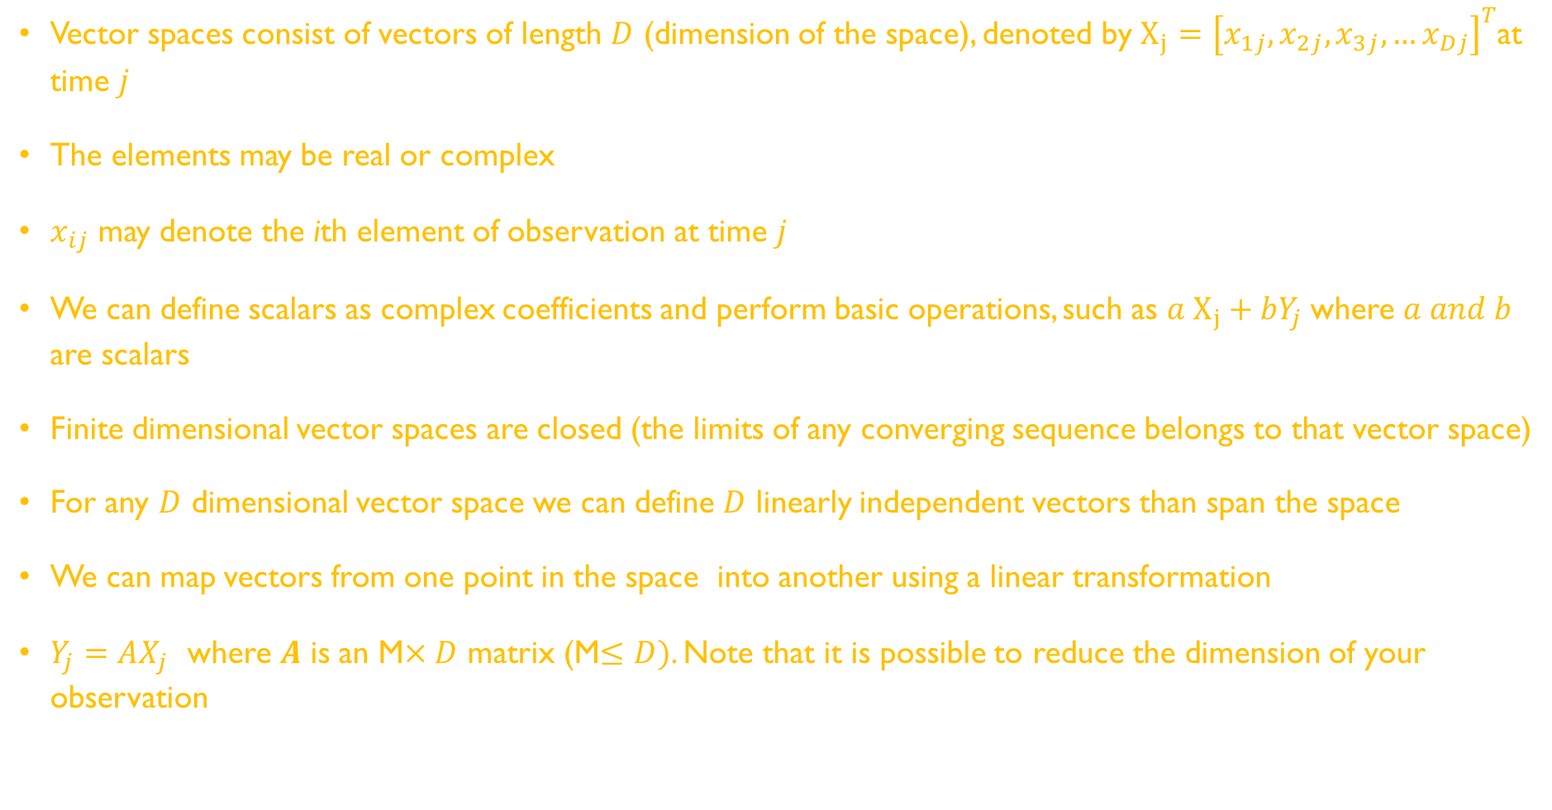
We need Linear Algebra
Vector spaces consist of vectors of length $D$ (dimension of the space), denoted by $X_{j}={\left[x_{1j},x_{2j},x_{3j},…x_{Dj}\right]}^{T}$at time $j$
The elements may be real or complex
$x_{ij}$ may denote the ith element of observation at time $j$
We can define scalars as complex coefficients and perform basic operations, such as $a X_{j}+bY_{j}$where $a and b$ are scalars
Finite dimensional vector spaces are closed (the limits of any converging sequence belongs to that vector space)
For any $D$ dimensional vector space we can define $D$ linearly independent vectors than span the space
We can map vectors from one point in the space into another using a linear transformation
$Y_{j}=AX_{j}$ where $A$ is an M$×D$ matrix (M$≤D)$. Note that it is possible to reduce the dimension of your observation

Slide 22
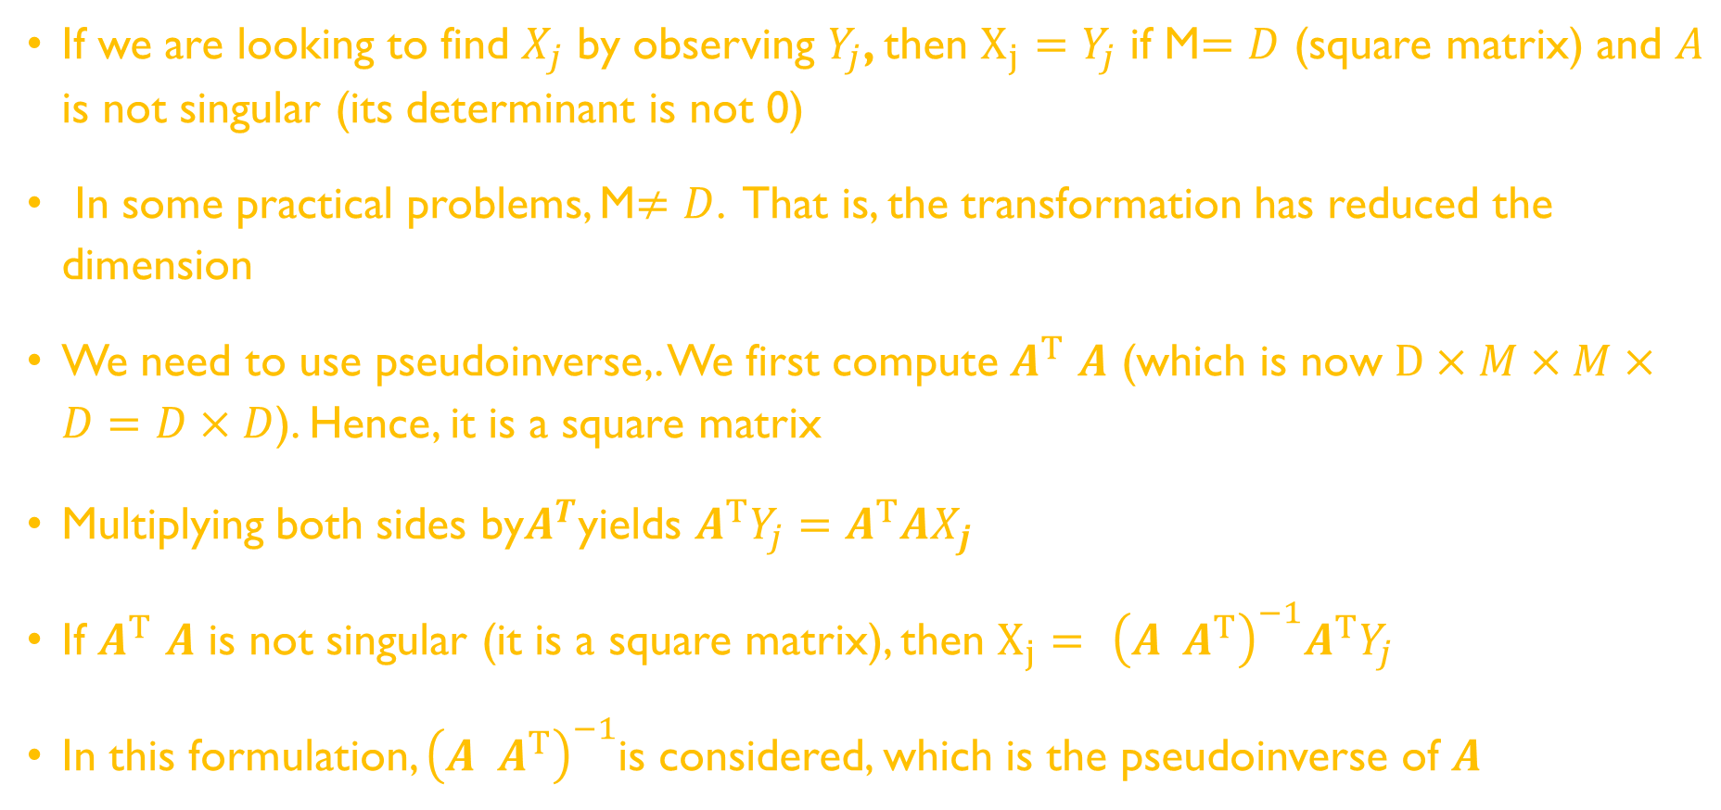
Linear Algebra (continue)
If we are looking to find $X_{j}$ by observing $Y_{j}$, then $X_{j}=Y_{j}$ if M$=D$ (square matrix) and $A$ is not singular (its determinant is not 0)
In some practical problems, M$≠D$. That is, the transformation has reduced the dimension
We need to use pseudoinverse,. We first compute $A^{T}$ $A$ (which is now $D×M×M×D=D×D$). Hence, it is a square matrix
Multiplying both sides by$A^{T}$yields $A^{T}Y_{j}=A^{T}AX_{j}$
If $A^{T}$ $A$ is not singular (it is a square matrix), then $X_{j}= {\left(A A^{T}\right)}^{−1}A^{T}Y_{j}$
In this formulation, ${\left(A A^{T}\right)}^{−1}$is considered, which is the pseudoinverse of $A$

Slide 23
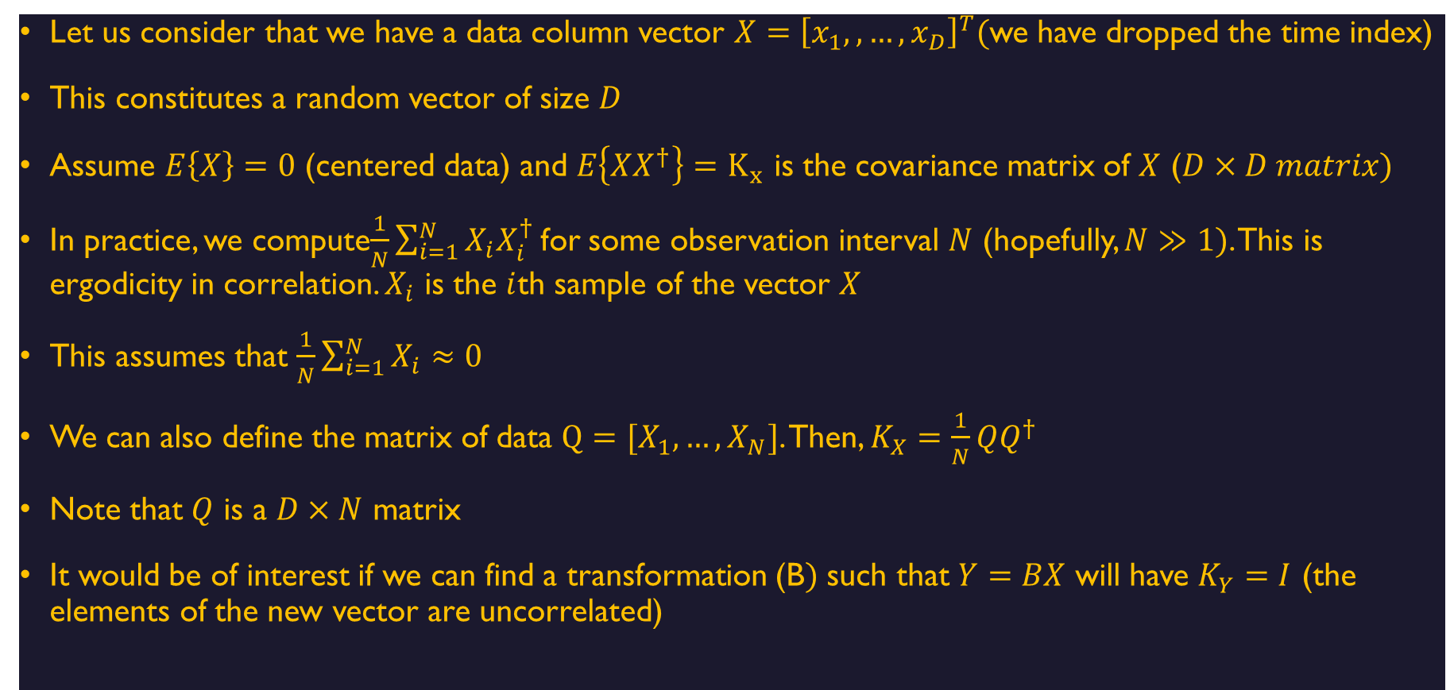
Data Transformation (making data uncorrelated)
Let us consider that we have a data column vector $X={\left[x_{1},,…,x_{D}\right]}^{T}($we have dropped the time index)
This constitutes a random vector of size $D$
Assume $E\left\{X\right\}=0$ (centered data) and $E\left\{XX^{†}\right\}=K_{x}$ is the covariance matrix of $X$ ($D×D matrix)$
In practice, we compute$\frac{1}{N}\sum_{i=1}^{N}{X_{i}X_{i}^{†}}$for some observation interval $N$ (hopefully, $N≫1)$. This is ergodicity in correlation. $X_{i}$ is the $i$th sample of the vector $X$
This assumes that $\frac{1}{N}\sum_{i=1}^{N}{X_{i}}≈0$
We can also define the matrix of data $Q=[X_{1},…,X_{N}]$. Then, $K_{X}=\frac{1}{N}QQ^{†}$
Note that $Q$ is a $D×N$ matrix
It would be of interest if we can find a transformation (B$)$ such that $Y=BX$ will have $K_{Y}=I$ (the elements of the new vector are uncorrelated)

Slide 24
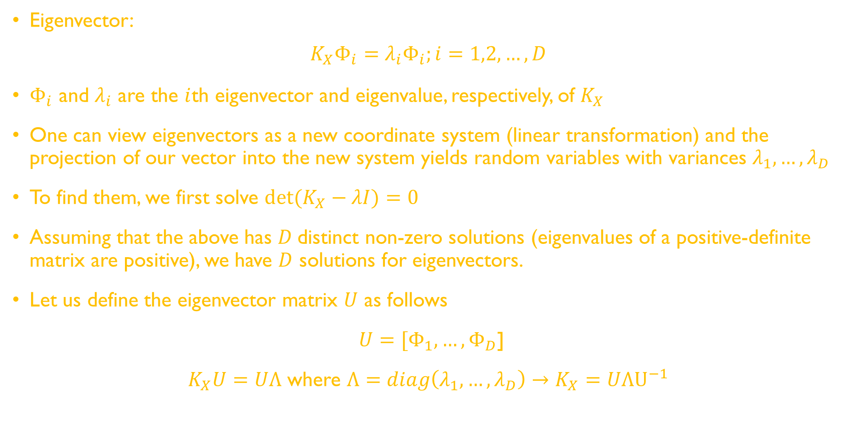
Eigenvalue Decomposition (EVD)
Eigenvector:
$$K_{X}Φ_{i}=λ_{i}Φ_{i};i=1,2,…,D$$
$Φ_{i}$ and $λ_{i}$ are the $i$th eigenvector and eigenvalue, respectively, of $K_{X}$
One can view eigenvectors as a new coordinate system (linear transformation) and the projection of our vector into the new system yields random variables with variances $λ_{1},…,λ_{D}$
To find them, we first solve $\det{(K_{X}−λI)}=0$
Assuming that the above has $D$distinct non-zero solutions (eigenvalues of a positive-definite matrix are positive), we have $D$ solutions for eigenvectors.
Let us define the eigenvector matrix $U$ as follows
$U=[Φ_{1},…,Φ_{D}$]
$K_{X}U=UΛ$ where $Λ=diag\left(λ_{1},…,λ_{D}\right)→K_{X}=UΛU^{−1}$

Slide 25
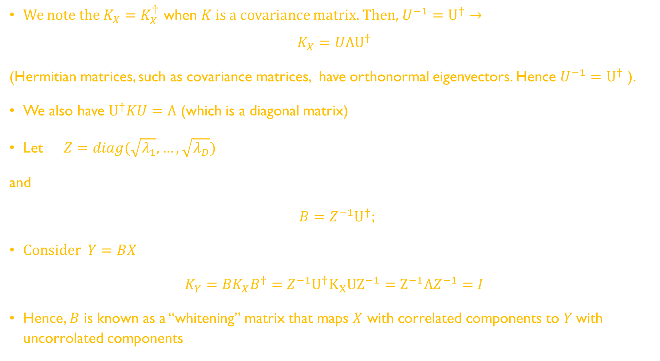
EVD
We note the $K_{X}=K_{X}^{†}$ when $K$ is a covariance matrix. Then, $U^{−1}=$ $U^{†}→$
$$K_{X}=UΛU^{†}$$
(Hermitian matrices, such as covariance matrices, have orthonormal eigenvectors. Hence $U^{−1}=$ $U^{†}$ ).
We also have $U^{†}KU=Λ$ (which is a diagonal matrix)
Let $Z=diag(\sqrt{λ_{1}},…,\sqrt{λ_{D}})$
and
$B=Z^{−1}U^{†}$;
Consider $Y=BX$
$K_{Y}=BK_{X}B^{†}=$ $Z^{−1}U^{†}K_{X}{UZ}^{−1}=Z^{−1}ΛZ^{−1}=I$
Hence, $B$ is known as a “whitening” matrix that maps $X$ with correlated components to $Y$with uncorrolated components

Slide 26
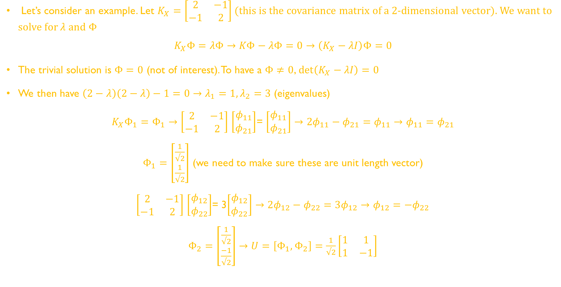
EVD
Let’s consider an example. Let $K_{X}=\left[\begin{matrix}2 & −1 \\ −1 & 2\end{matrix}\right]$ (this is the covariance matrix of a 2-dimensional vector). We want to solve for $λ$ and $Φ$
$$K_{X}Φ=λΦ→KΦ−λΦ=0→\left(K_{X}−λI\right)Φ=0$$
The trivial solution is $Φ=0$ (not of interest). To have a $Φ≠0$, $\det\left(K_{X}−λI\right)=0$
We then have $\left(2−λ\right)\left(2−λ\right)−1=0→λ_{1}=1, λ_{2}=3$ (eigenvalues)
$K_{X}Φ_{1}=Φ_{1}→$ $\left[\begin{matrix}2 & −1 \\ −1 & 2\end{matrix}\right]$ $\left[\begin{matrix}φ_{11} \\ φ_{21}\end{matrix}\right]$= $\left[\begin{matrix}φ_{11} \\ φ_{21}\end{matrix}\right]→2φ_{11}−φ_{21}=φ_{11}→φ_{11}=φ_{21}$
$Φ_{1}=$ $\left[\begin{matrix}\frac{1}{√2} \\ \frac{1}{√2}\end{matrix}\right]$ (we need to make sure these are unit length vector)
$\left[\begin{matrix}2 & −1 \\ −1 & 2\end{matrix}\right]$ $\left[\begin{matrix}φ_{12} \\ φ_{22}\end{matrix}\right]$= 3$\left[\begin{matrix}φ_{12} \\ φ_{22}\end{matrix}\right]→2φ_{12}−φ_{22}=3φ_{12}→φ_{12}={−φ}_{22}$
$Φ_{2}=$ $\left[\begin{matrix}\frac{1}{√2} \\ \frac{−1}{√2}\end{matrix}\right]→U=\left[Φ_{1},Φ_{2}\right]=\frac{1}{√2}\left[\begin{matrix}1 & 1 \\ 1 & −1\end{matrix}\right]$

Slide 27
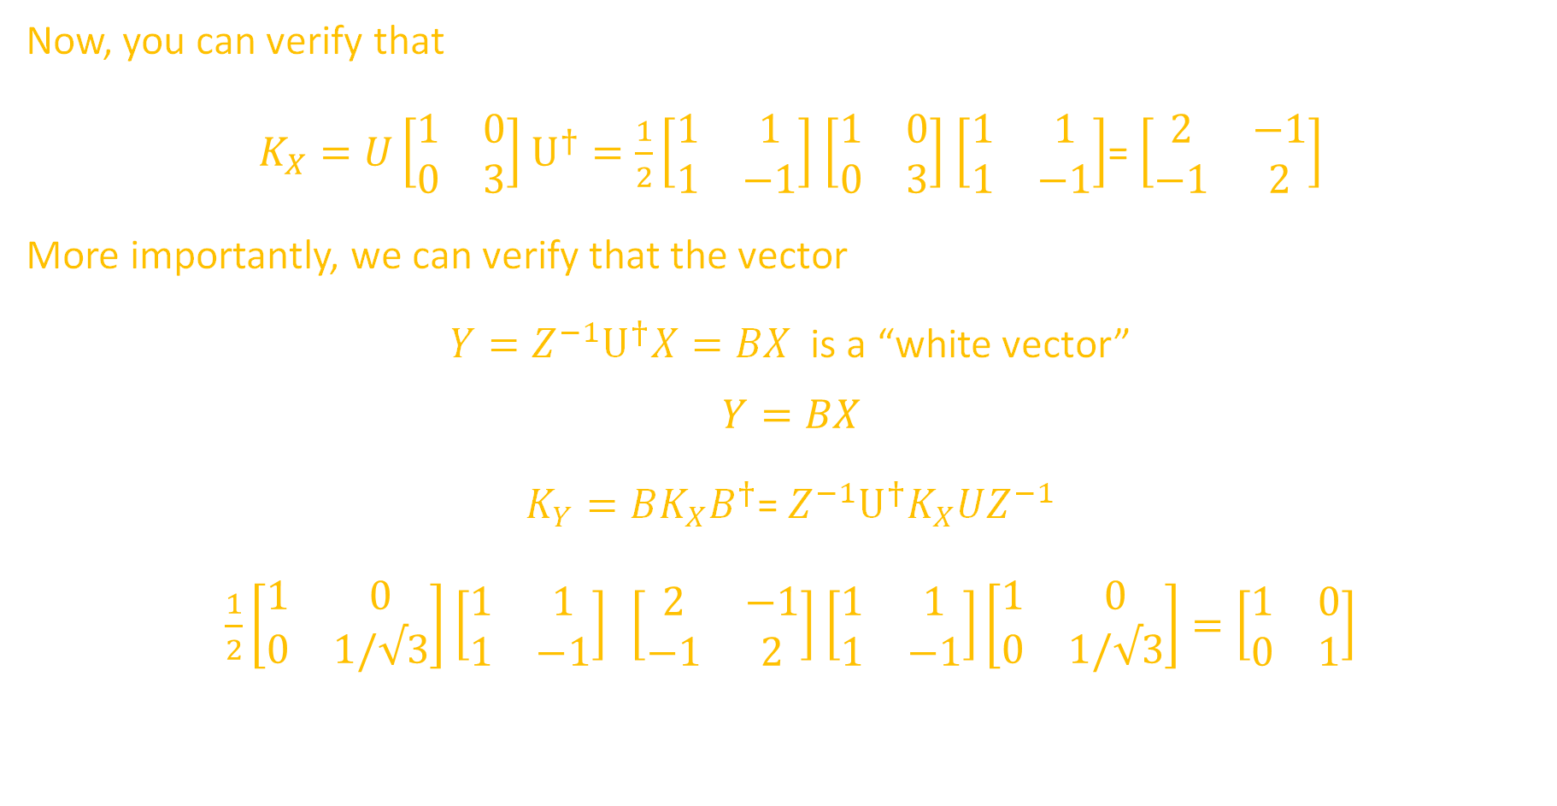
EVD
Now, you can verify that
$K_{X}=U\left[\begin{matrix}1 & 0 \\ 0 & 3\end{matrix}\right]$ $U^{†}=\frac{1}{2}\left[\begin{matrix}1 & 1 \\ 1 & −1\end{matrix}\right]$ $\left[\begin{matrix}1 & 0 \\ 0 & 3\end{matrix}\right]$ $\left[\begin{matrix}1 & 1 \\ 1 & −1\end{matrix}\right]$= $\left[\begin{matrix}2 & −1 \\ −1 & 2\end{matrix}\right]$
More importantly, we can verify that the vector
$Y=Z^{−1}U^{†}X=BX$ is a “white vector”
$$Y=BX$$
$K_{Y}=BK_{X}B^{†}$= $Z^{−1}U^{†}K_{X}UZ^{−1}$
$\frac{1}{2}\left[\begin{matrix}1 & 0 \\ 0 & 1/√3\end{matrix}\right]$ $\left[\begin{matrix}1 & 1 \\ 1 & −1\end{matrix}\right] \left[\begin{matrix}2 & −1 \\ −1 & 2\end{matrix}\right]$ $\left[\begin{matrix}1 & 1 \\ 1 & −1\end{matrix}\right]\left[\begin{matrix}1 & 0 \\ 0 & 1/√3\end{matrix}\right]=\left[\begin{matrix}1 & 0 \\ 0 & 1\end{matrix}\right]$

Slide 28
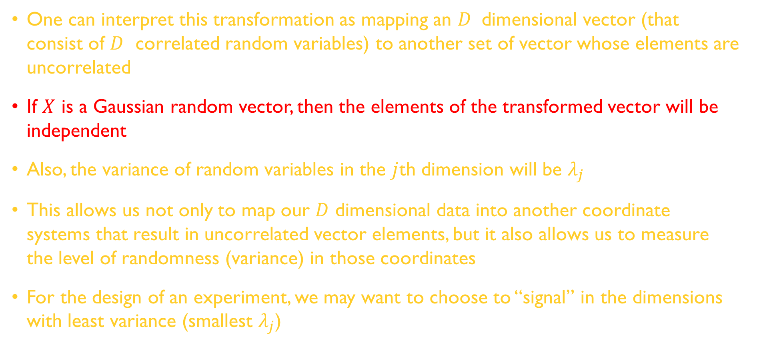
EVD
One can interpret this transformation as mapping an $D$ dimensional vector (that consist of $D$ correlated random variables) to another set of vector whose elements are uncorrelated
If $X$ is a Gaussian random vector, then the elements of the transformed vector will be independent
Also, the variance of random variables in the $j$th dimension will be $λ_{j}$
This allows us not only to map our $D$ dimensional data into another coordinate systems that result in uncorrelated vector elements, but it also allows us to measure the level of randomness (variance) in those coordinates
For the design of an experiment, we may want to choose to “signal” in the dimensions with least variance (smallest $λ_{j}$)

Slide 29
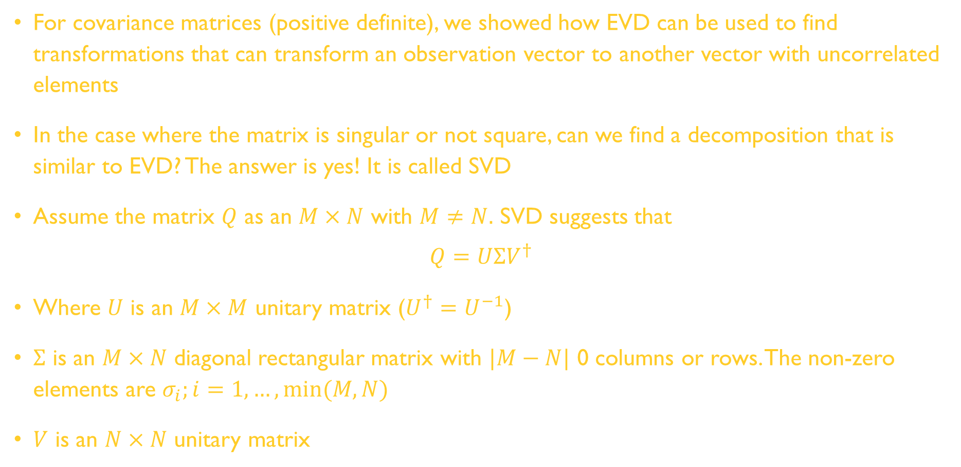
Singular Value Decomposition (SVD)
For covariance matrices (positive definite), we showed how EVD can be used to find transformations that can transform an observation vector to another vector with uncorrelated elements
In the case where the matrix is singular or not square, can we find a decomposition that is similar to EVD? The answer is yes! It is called SVD
Assume the matrix $Q$ as an $M×N$ with $M≠N.$ SVD suggests that
$$Q=UΣV^{†}$$
Where $U$ is an $M×M$ unitary matrix ($U^{†}=U^{−1}$)
$Σ$ is an $M×N$ diagonal rectangular matrix with $|M−N|$ 0 columns or rows. The non-zero elements are $σ_{i};i=1,…,min⁡(M,N)$
$V$ is an $N×N$ unitary matrix

Slide 30
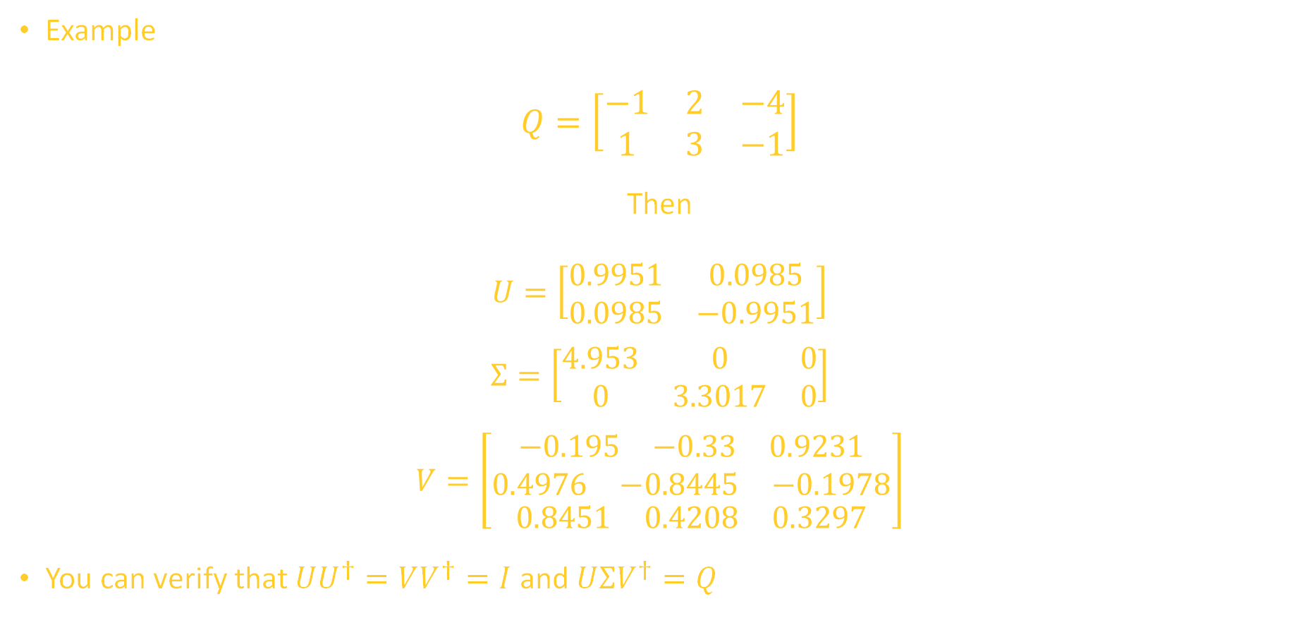
SVD
Example
$Q=\left[\begin{matrix}−1 & 2 & −4 \\ 1 & 3 & −1\end{matrix}\right]$
Then
$U=\left[\begin{matrix}0.9951 & 0.0985 \\ 0.0985 & −0.9951\end{matrix}\right]$
$$Σ=\left[\begin{matrix}4.953 & 0 & 0 \\ 0 & 3.3017 & 0\end{matrix}\right]$$
$$V=\left[\begin{aligned}\begin{aligned}\begin{matrix}−0.195 & −0.33 & 0.9231\end{matrix} \\ \begin{matrix}0.4976 & −0.8445 & −0.1978\end{matrix}\end{aligned} \\ \begin{matrix}0.8451 & 0.4208 & 0.3297\end{matrix}\end{aligned}\right]$$
You can verify that $UU^{†}=VV^{†}=I$ and $UΣV^{†}=Q$

Slide 31
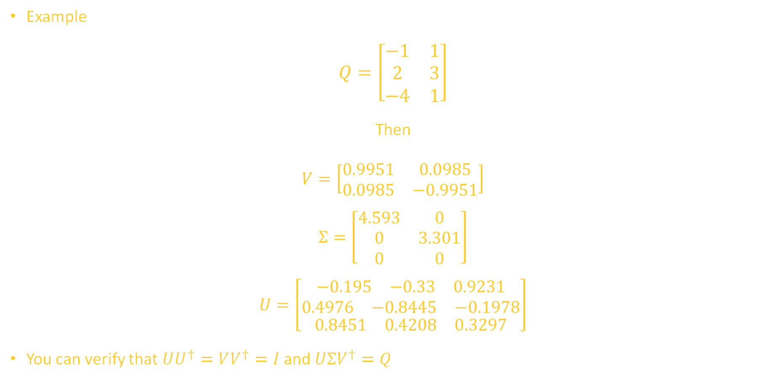
SVD
Example
$$Q=\left[\begin{matrix}−1 & 1 \\ 2 & 3 \\ −4 & 1\end{matrix}\right]$$
Then
$V=\left[\begin{matrix}0.9951 & 0.0985 \\ 0.0985 & −0.9951\end{matrix}\right]$
$$Σ=\left[\begin{matrix}4.593 & 0 \\ 0 & 3.301 \\ 0 & 0\end{matrix}\right]$$
$$U=\left[\begin{aligned}\begin{aligned}\begin{matrix}−0.195 & −0.33 & 0.9231\end{matrix} \\ \begin{matrix}0.4976 & −0.8445 & −0.1978\end{matrix}\end{aligned} \\ \begin{matrix}0.8451 & 0.4208 & 0.3297\end{matrix}\end{aligned}\right]$$
You can verify that $UU^{†}=VV^{†}=I$ and $UΣV^{†}=Q$

Slide 32
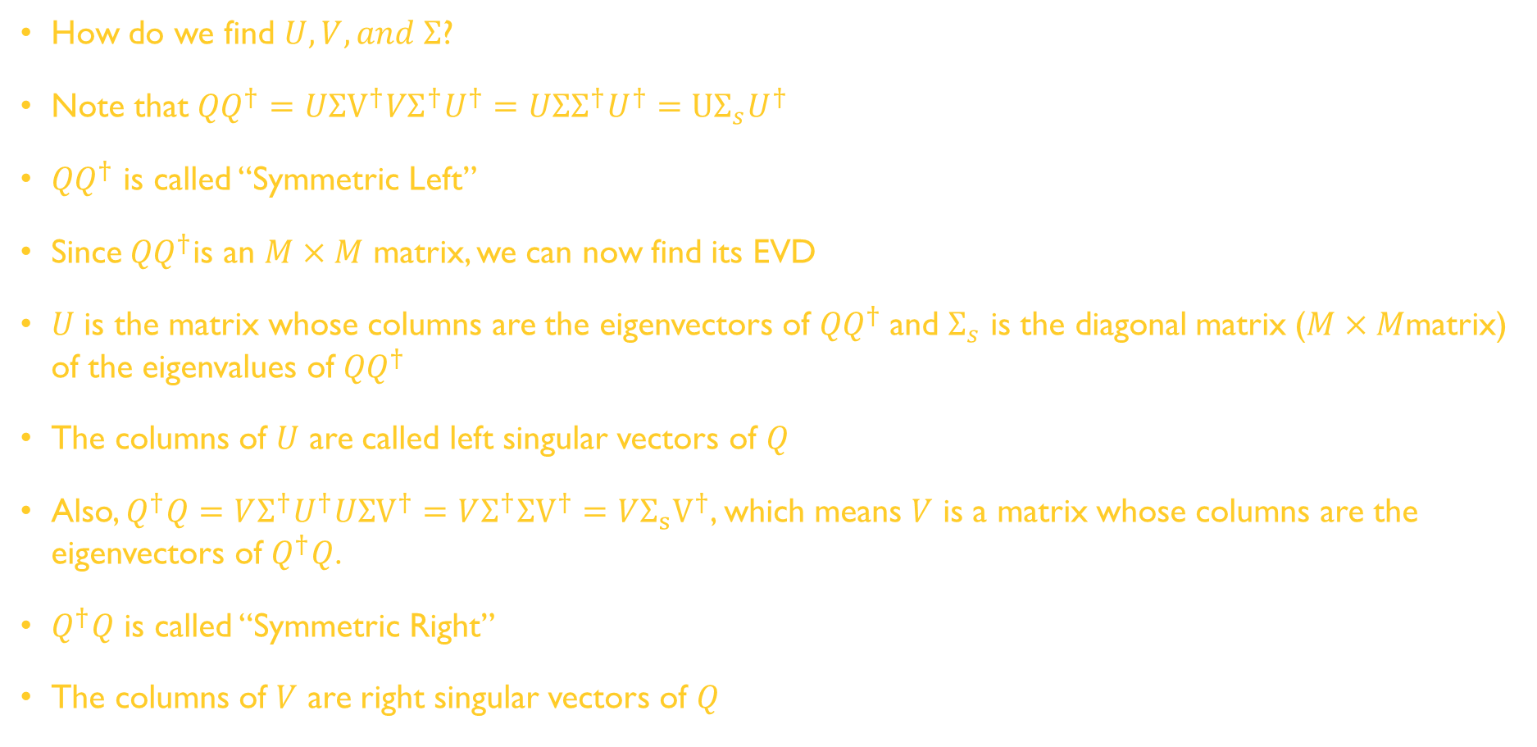
SVD
How do we find $U, V, and Σ$?
Note that ${QQ}^{†}=UΣV^{†}VΣ^{†}U^{†}=UΣΣ^{†}U^{†}=UΣ_{s}U^{†}$
${QQ}^{†}$ is called “Symmetric Left”
Since${QQ}^{†}$is an $M×M$ matrix, we can now find its EVD
$U$ is the matrix whose columns are the eigenvectors of ${QQ}^{†}$and $Σ_{s}$ is the diagonal matrix ($M×M$matrix) of the eigenvalues of ${QQ}^{†}$
The columns of $U$ are called left singular vectors of $Q$
Also, $Q^{†}Q=VΣ^{†}U^{†}UΣV^{†}=VΣ^{†}ΣV^{†}=VΣ_{s}V^{†}$, which means $V$ is a matrix whose columns are the eigenvectors of $Q^{†}Q$.
$Q^{†}Q$ is called “Symmetric Right”
The columns of $V$ are right singular vectors of $Q$

Slide 33
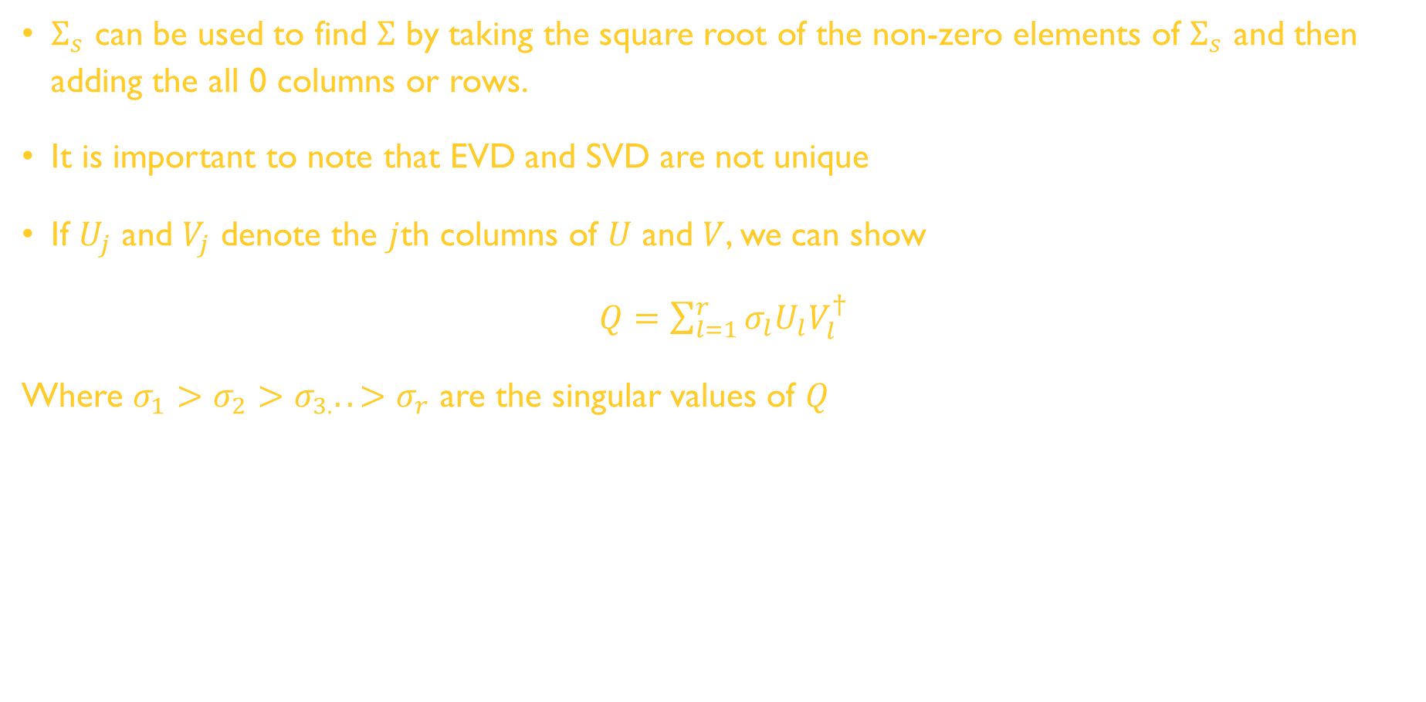
SVD
$Σ_{s}$ can be used to find $Σ$ by taking the square root of the non-zero elements of $Σ_{s}$ and then adding the all 0 columns or rows.
It is important to note that EVD and SVD are not unique
If $U_{j}$ and $V_{j}$ denote the $j$th columns of $U$ and $V$, we can show
$Q=\sum_{l=1}^{r}{σ_{l}U_{l}V_{l}^{†}}$
Where $σ_{1}>σ_{2}>σ_{3.}..>σ_{r}$ are the singular values of $Q$

Slide 34
Principle Component Analysis (PCA)
PCA provides several benefits
It can reduce dimension (dimensionality reduction)
Data visualization
Data preprocessing (used in ML algorithms)
Identifying correlation

Slide 35
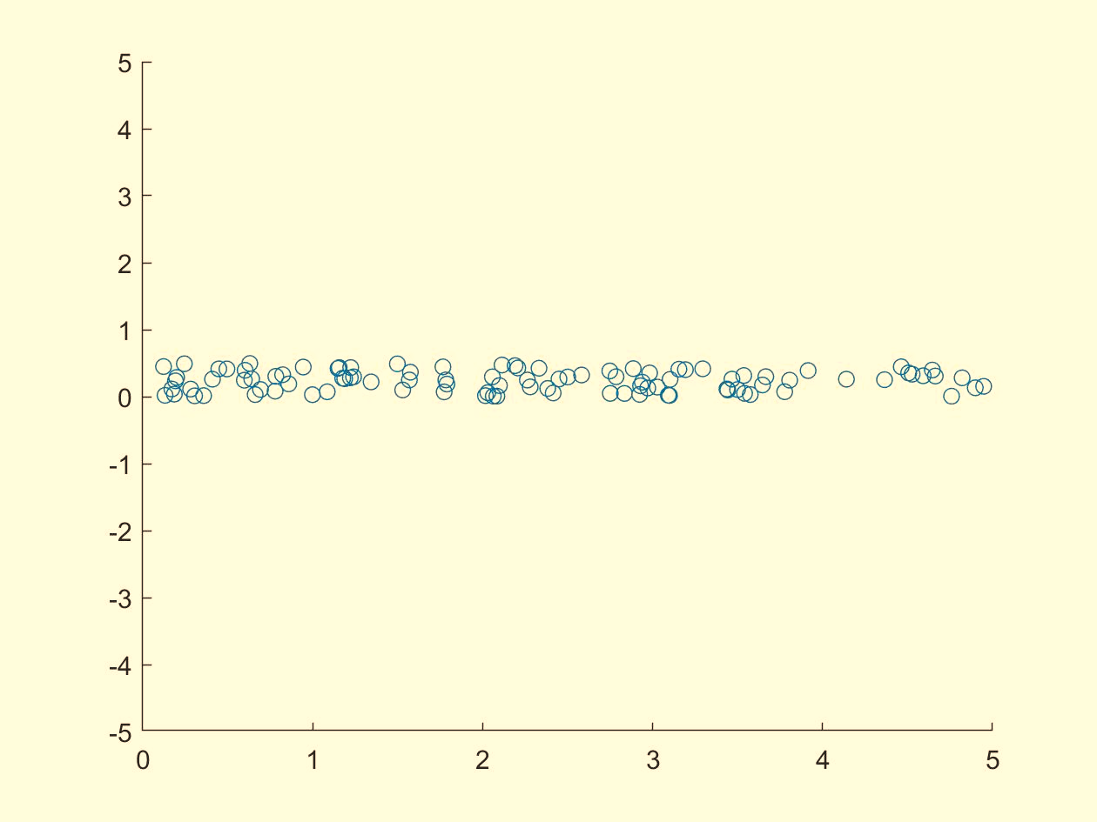
Principle Component Analysis-What is the dimension of my data?

Slide 36
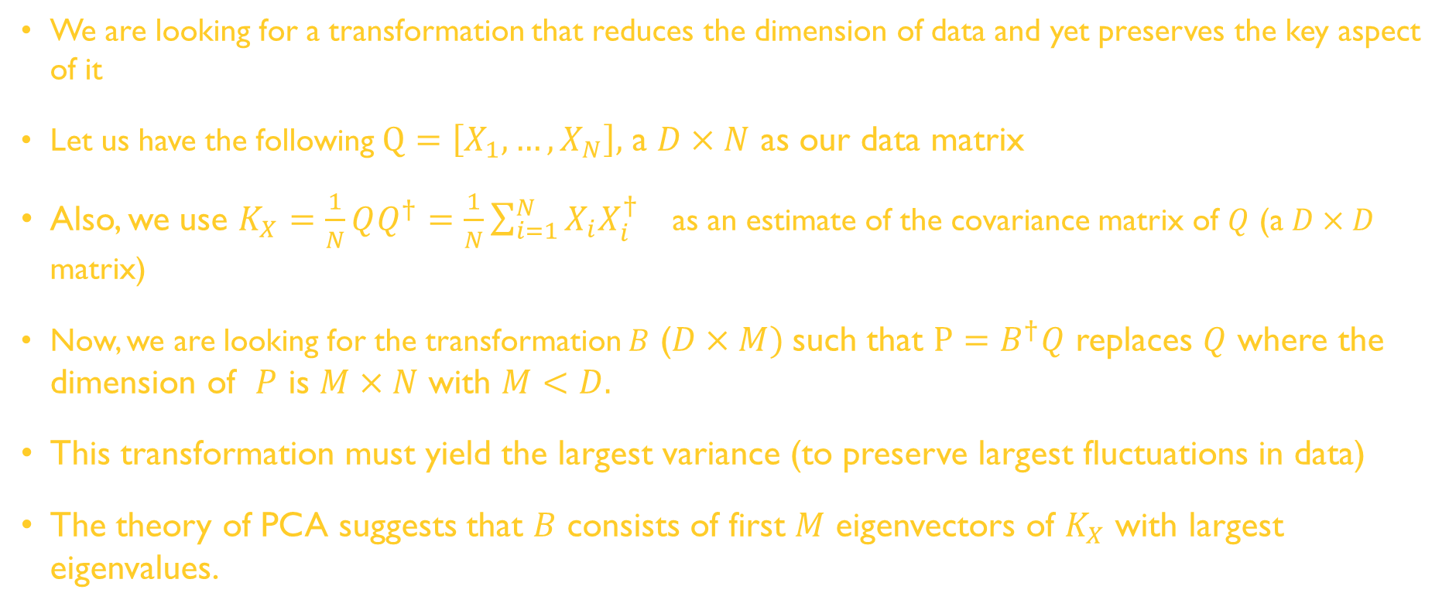
PCA
We are looking for a transformation that reduces the dimension of data and yet preserves the key aspect of it
Let us have the following $Q=\left[X_{1},…,X_{N}\right],$ a $D×N$ as our data matrix
Also, we use $K_{X}=\frac{1}{N}QQ^{†}=\frac{1}{N}\sum_{i=1}^{N}{X_{i}X_{i}^{†}}$ as an estimate of the covariance matrix of $Q$ (a $D×D$ matrix)
Now, we are looking for the transformation $B$ ($D×M)$such that $P=B^{†}Q$ replaces $Q$ where the dimension of $P$ is $M×N$ with $M<D.$
This transformation must yield the largest variance (to preserve largest fluctuations in data)
The theory of PCA suggests that $B$ consists of first $M$ eigenvectors of $K_{X}$ with largest eigenvalues.

Slide 37
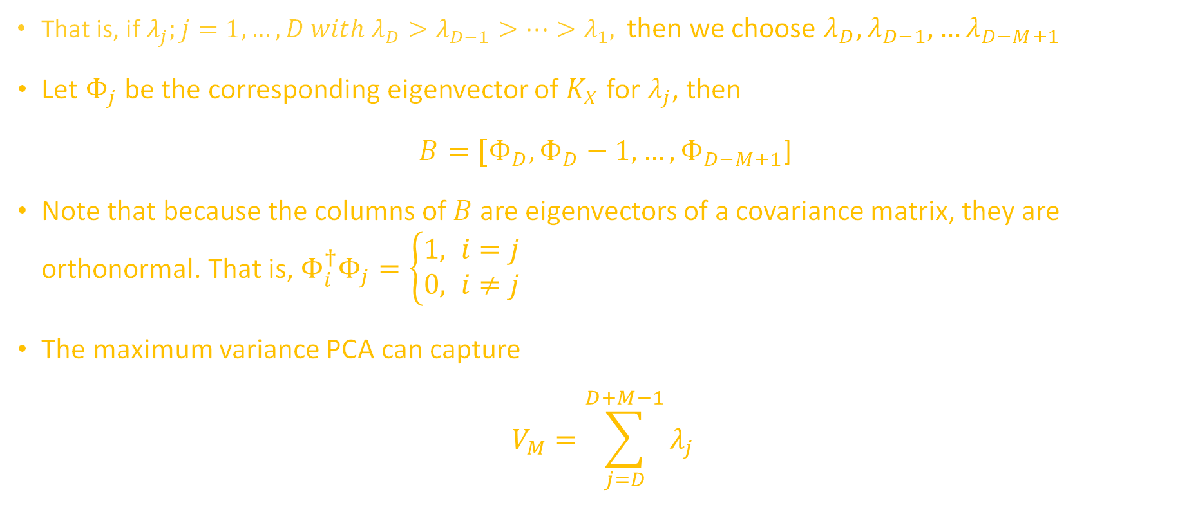
PCA
That is, if $λ_{j};j=1,…,D with λ_{D}>λ_{D−1}>…>λ_{1},$then we choose $λ_{D},λ_{D−1},…λ_{D−M+1}$
Let $Φ_{j}$ be the corresponding eigenvector of $K_{X}$ for $λ_{j}$, then
$B=[Φ_{D},Φ_{D}−1,…,Φ_{D−M+1}$]
Note that because the columns of $B$ are eigenvectors of a covariance matrix, they are orthonormal. That is, $Φ_{i}^{†}Φ_{j}=\left\{\begin{aligned}1, i=j \\ &0, i≠j\end{aligned}\right.$
The maximum variance PCA can capture
$$V_{M}=\sum_{j=D}^{D+M−1}{λ_{j}}$$

Slide 38
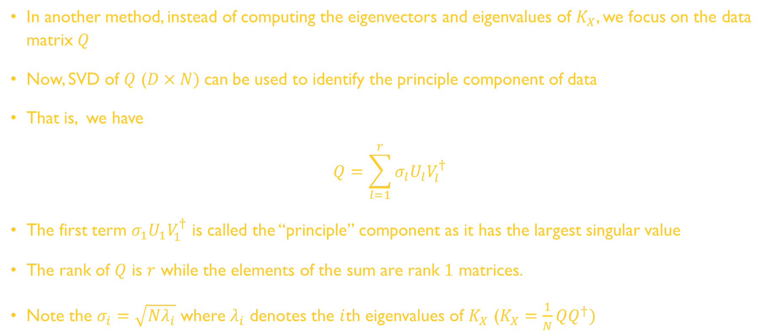
PCA
In another method, instead of computing the eigenvectors and eigenvalues of $K_{X}$, we focus on the data matrix $Q$
Now, SVD of $Q$ ($D×N)$can be used to identify the principle component of data
That is, we have
$$Q=\sum_{l=1}^{r}{σ_{l}U_{l}V_{l}^{†}}$$
The first term $σ_{1}U_{1}V_{1}^{†}$ is called the “principle” component as it has the largest singular value
The rank of $Q$ is $r$ while the elements of the sum are rank $1$ matrices.
Note the $σ_{i}=\sqrt{Nλ_{i}}$ where $λ_{i}$ denotes the $i$th eigenvalues of $K_{X}$ ($K_{X}=\frac{1}{N}QQ^{†})$

Slide 39
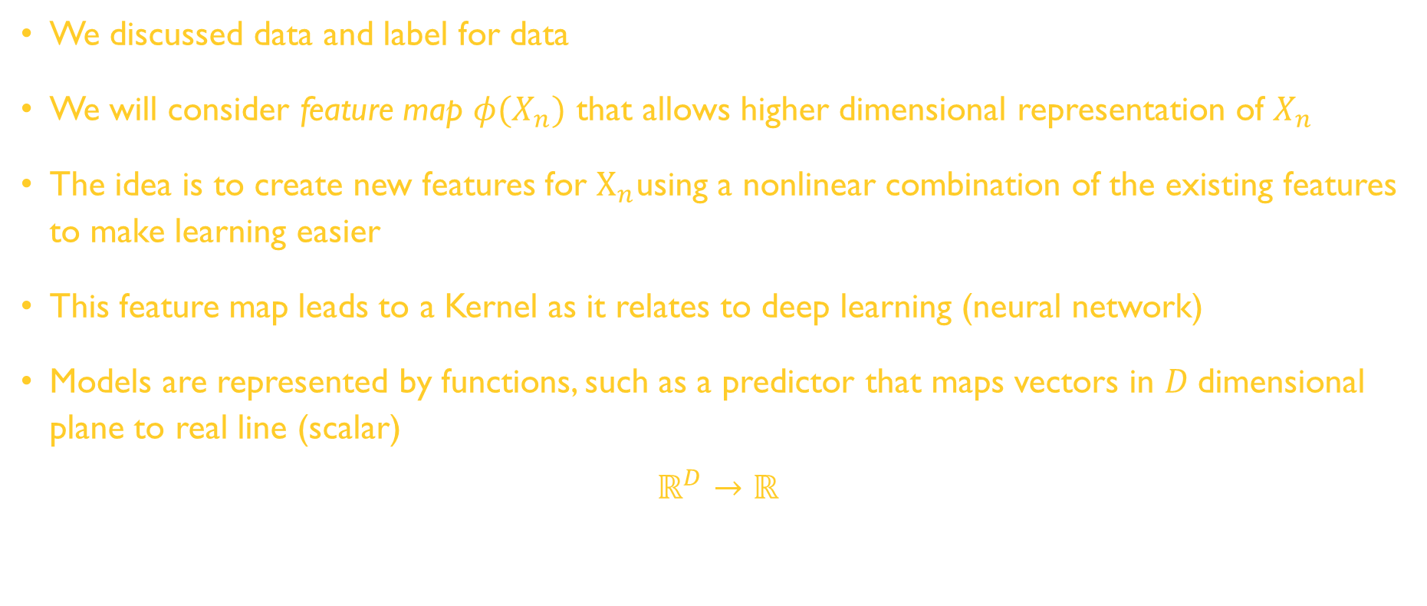
Data, Model, and Learning
We discussed data and label for data
We will consider feature map $φ(X_{n})$ that allows higher dimensional representation of $X_{n}$
The idea is to create new features for $X_{n}$using a nonlinear combination of the existing features to make learning easier
This feature map leads to a Kernel as it relates to deep learning (neural network)
Models are represented by functions, such as a predictor that maps vectors in $D$dimensional plane to real line (scalar)
$$ℝ^{D}→ℝ$$

Slide 40
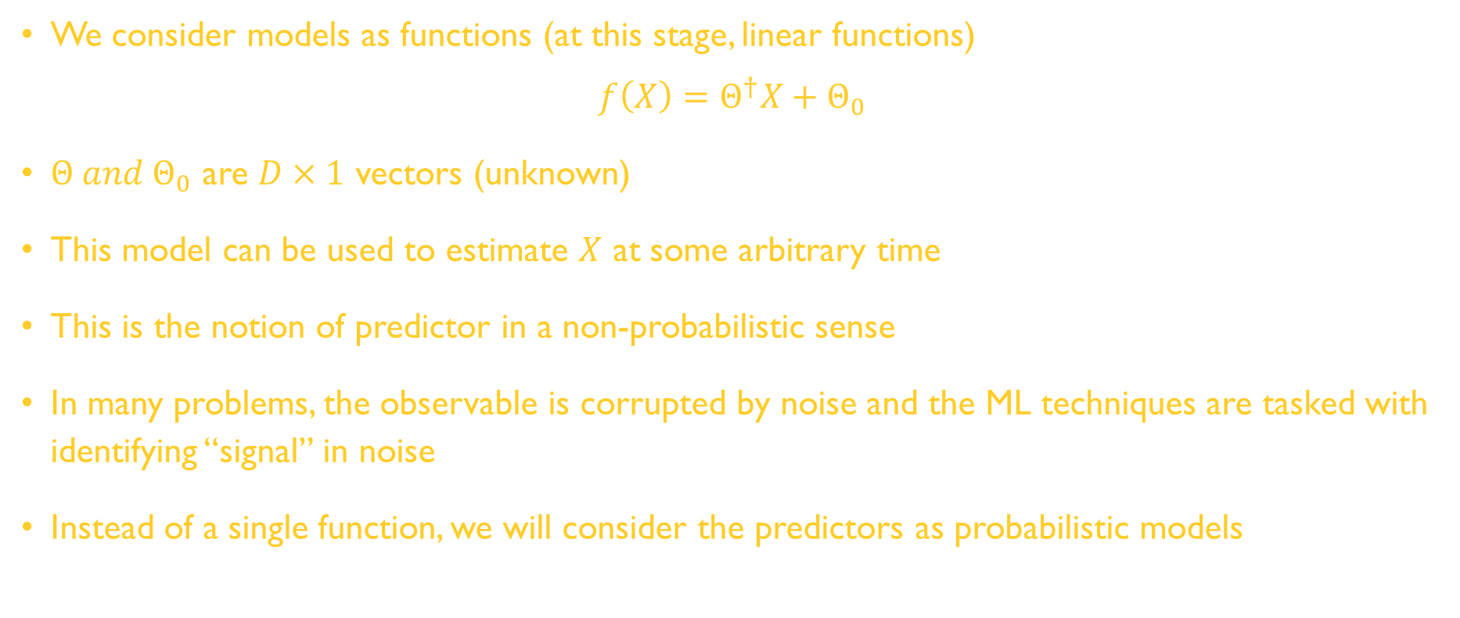
Data, Model, and Learning
We consider models as functions (at this stage, linear functions)
$$f\left(X\right)=Θ^{†}X+Θ_{0}$$
$Θ and Θ_{0}$ are $D×1$ vectors (unknown)
This model can be used to estimate $X$ at some arbitrary time
This is the notion of predictor in a non-probabilistic sense
In many problems, the observable is corrupted by noise and the ML techniques are tasked with identifying “signal” in noise
Instead of a single function, we will consider the predictors as probabilistic models

Slide 41
Data, Model, and Learning
We will be concerned with learning as a problem of finding parameters
Three algorithmic phases for ML
Prediction or Inference (where we use a trained predictor on previously unseen data)
Training or Parameter Estimation
Hyperparameter tuning or Model Selection
It is important to decide whether we are dealing with a deterministic versus probabilistic model
Empirical Risk Minimization can be used to build a predictor to minimize risk in making a decision
Least square is such an example

Slide 42
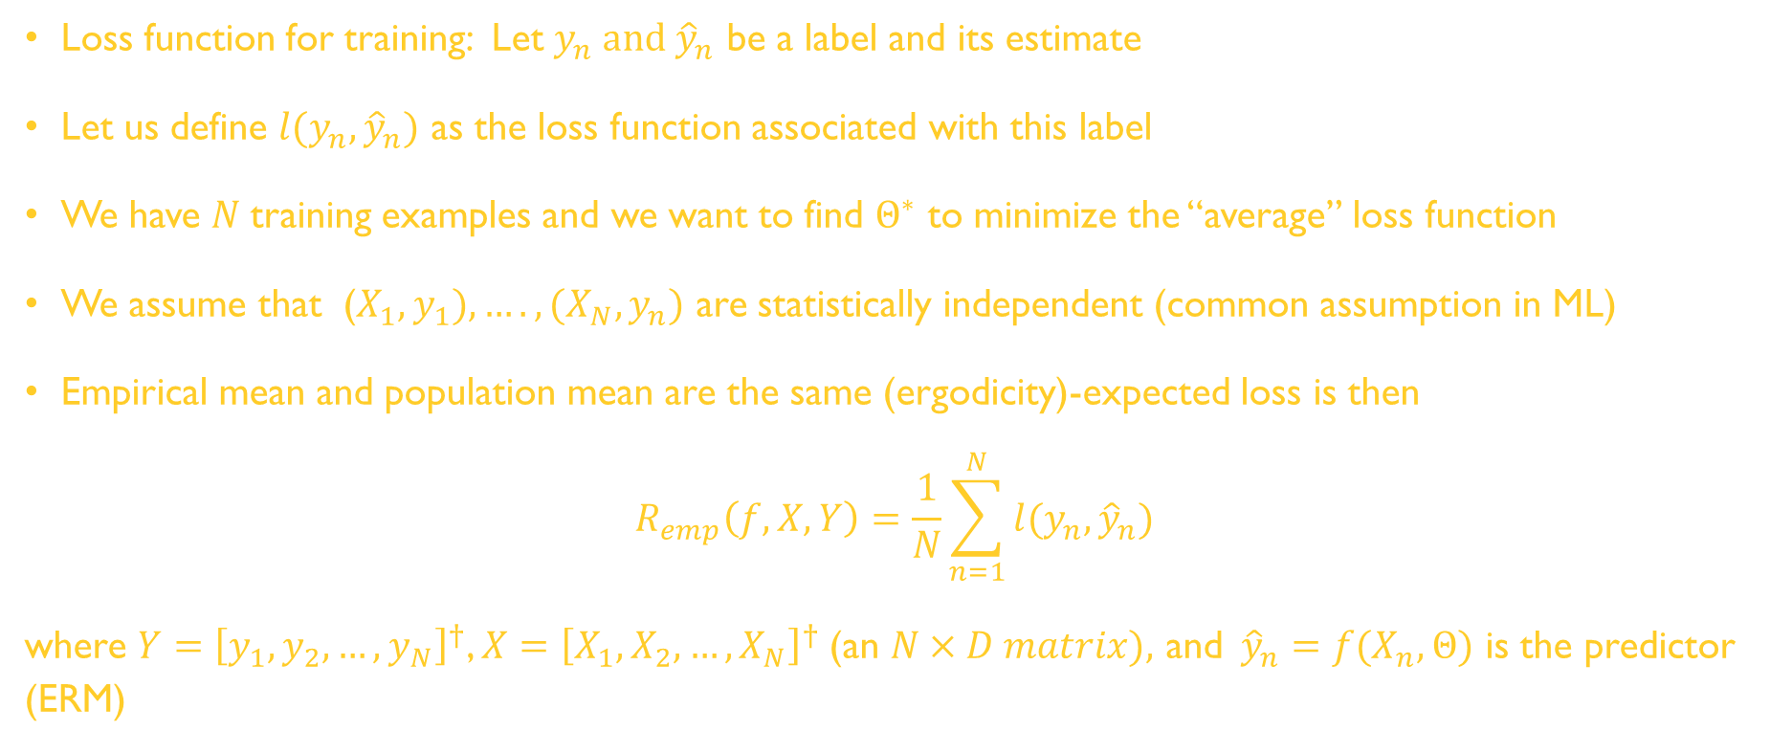
Empirical Risk Minimization (ERM)
Loss function for training: Let $y_{n} and {\hat{y}}_{n}$ be a label and its estimate
Let us define $l(y_{n},{\hat{y}}_{n})$ as the loss function associated with this label
We have $N$training examples and we want to find $Θ^{∗}$ to minimize the “average” loss function
We assume that ($X_{1},y_{1}),….,(X_{N},y_{n})$ are statistically independent (common assumption in ML)
Empirical mean and population mean are the same (ergodicity)-expected loss is then
$$R_{emp}\left(f,X,Y\right)=\frac{1}{N}\sum_{n=1}^{N}{l(y_{n},{\hat{y}}_{n})}$$
where $Y={\left[y_{1},y_{2},…,y_{N}\right]}^{†}$, $X={\left[X_{1},X_{2},…,X_{N}\right]}^{†}$(an $N×D matrix),$ and${\hat{y}}_{n}=f(X_{n},Θ)$ is the predictor (ERM)

Slide 43
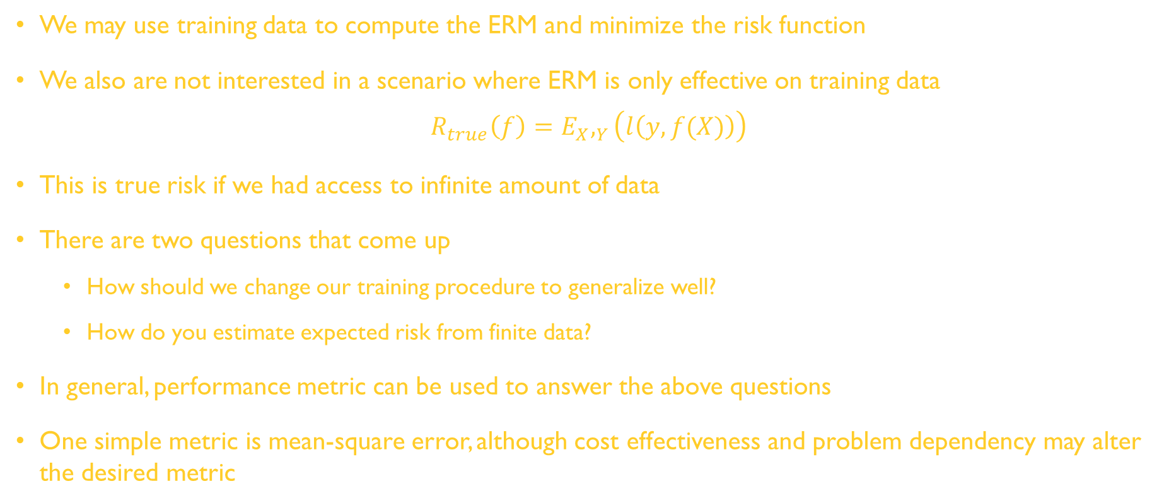
ERM
We may use training data to compute the ERM and minimize the risk function
We also are not interested in a scenario where ERM is only effective on training data
$$R_{true}\left(f\right)=E_{X},_{Y}\left(l\left(y,f(X)\right)\right)$$
This is true risk if we had access to infinite amount of data
There are two questions that come up
How should we change our training procedure to generalize well?
How do you estimate expected risk from finite data?
In general, performance metric can be used to answer the above questions
One simple metric is mean-square error, although cost effectiveness and problem dependency may alter the desired metric

Slide 44
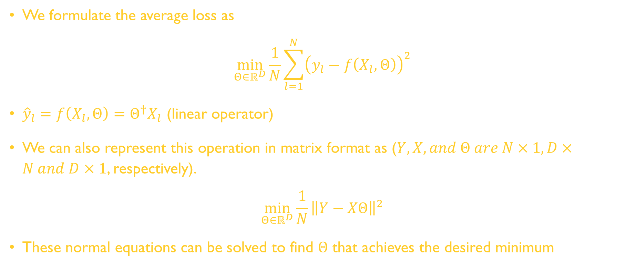
Example of ERM (Least Square Problem)
We formulate the average loss as
$$\min_{Θ∈ℝ^{D}}{\frac{1}{N}\sum_{l=1}^{N}{{\left(y_{l}−f\left(X_{l},Θ\right)\right)}^{2}}}$$
${\hat{y}}_{l}=f\left(X_{l},Θ\right)=Θ^{†}X_{l}$ (linear operator)
We can also represent this operation in matrix format as ($Y, X, and Θ are N×1, D×N and D×1$, respectively).
$$\min_{Θ∈ℝ^{D}}{\frac{1}{N}{\left\|Y−XΘ\right\|}^{2}}$$
These normal equations can be solved to find $Θ$ that achieves the desired minimum

Slide 45
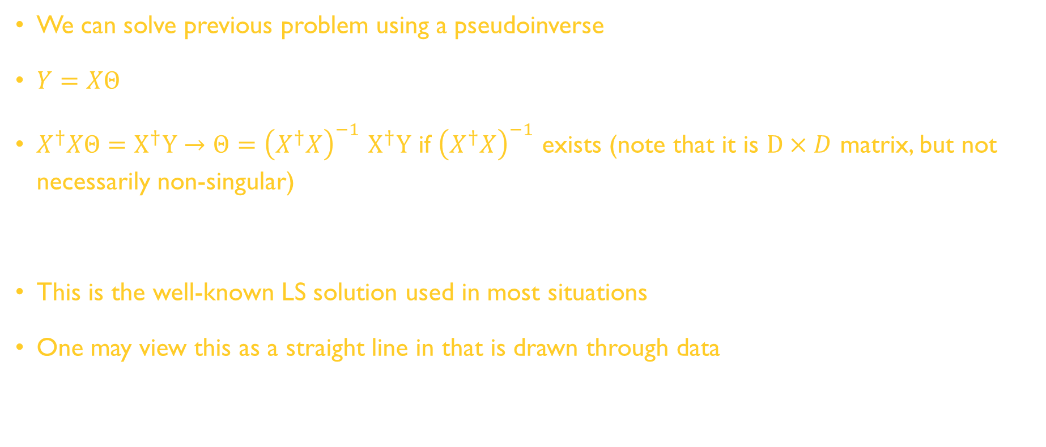
Example of ERM (Least Square Problem)
We can solve previous problem using a pseudoinverse
$Y=XΘ$
$X^{†}XΘ=X^{†}Y→Θ={\left(X^{†}X\right)}^{−1}$ $X^{†}Y$ if ${\left(X^{†}X\right)}^{−1}$ exists (note that it is $D×D$ matrix, but not necessarily non-singular)
This is the well-known LS solution used in most situations
One may view this as a straight line in that is drawn through data

Slide 46
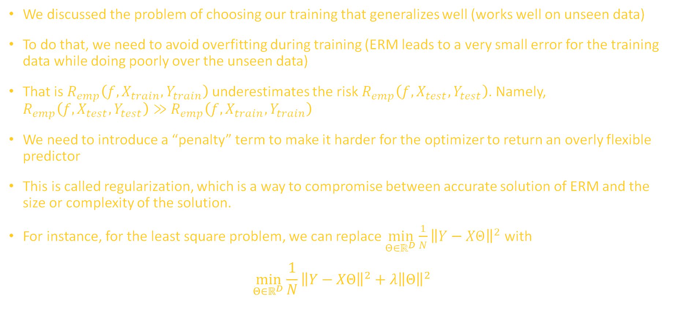
Example of ERM (Least Square Problem)
We discussed the problem of choosing our training that generalizes well (works well on unseen data)
To do that, we need to avoid overfitting during training (ERM leads to a very small error for the training data while doing poorly over the unseen data)
That is $R_{emp}\left(f,X_{train},Y_{train}\right)$ underestimates the risk $R_{emp}\left(f,X_{test},Y_{test}\right)$. Namely, $R_{emp}\left(f,X_{test},Y_{test}\right)≫$ $R_{emp}\left(f,X_{train},Y_{train}\right)$
We need to introduce a “penalty” term to make it harder for the optimizer to return an overly flexible predictor
This is called regularization, which is a way to compromise between accurate solution of ERM and the size or complexity of the solution.
For instance, for the least square problem, we can replace $\min_{Θ∈ℝ^{D}}{\frac{1}{N}{\left\|Y−XΘ\right\|}^{2}}$ with
$$\min_{Θ∈ℝ^{D}}{\frac{1}{N}{\left\|Y−XΘ\right\|}^{2}+λ{\left\|Θ\right\|}^{2}}$$
regularizer
regularization param.

Slide 47
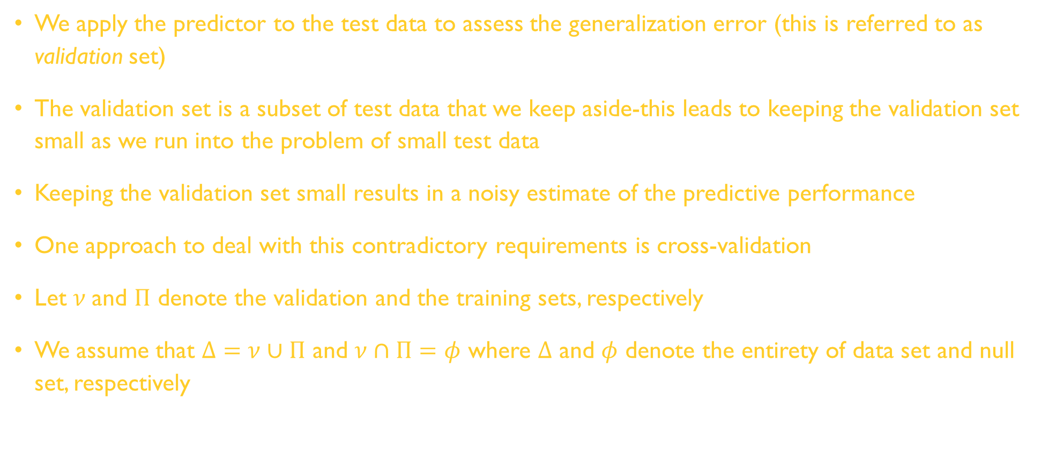
Cross-Validation to Assess Generalization Performance
We apply the predictor to the test data to assess the generalization error (this is referred to as validation set)
The validation set is a subset of test data that we keep aside-this leads to keeping the validation set small as we run into the problem of small test data
Keeping the validation set small results in a noisy estimate of the predictive performance
One approach to deal with this contradictory requirements is cross-validation
Let $ν$and $Π$ denote the validation and the training sets, respectively
We assume that $Δ=ν∪Π$ and $ν∩Π=φ$ where $Δ$ and $φ$ denote the entirety of data set and null set, respectively

Slide 48




















Cross-Validation to Assess Generalization Performance

Slide 49
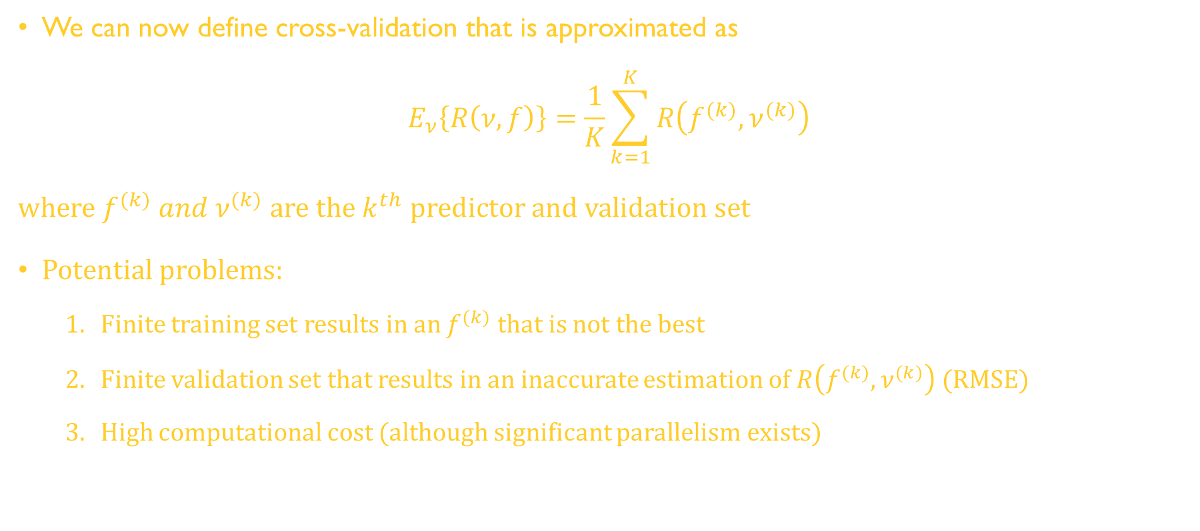
Cross-Validation to Assess Generalization Performance
We can now define cross-validation that is approximated as
$$E_{ν}\left\{R\left(ν,f\right)\right\}=\frac{1}{K}\sum_{k=1}^{K}{R\left(f^{(k)},ν^{(k)}\right)}$$
where $f^{(k)} and ν^{(k)}$ are the $k^{th}$ predictor and validation set
Potential problems:
Finite training set results in an $f^{(k)}$ that is not the best
Finite validation set that results in an inaccurate estimation of $R\left(f^{(k)},ν^{(k)}\right)$ (RMSE)
High computational cost (although significant parallelism exists)
Notes:
o

Slide 50
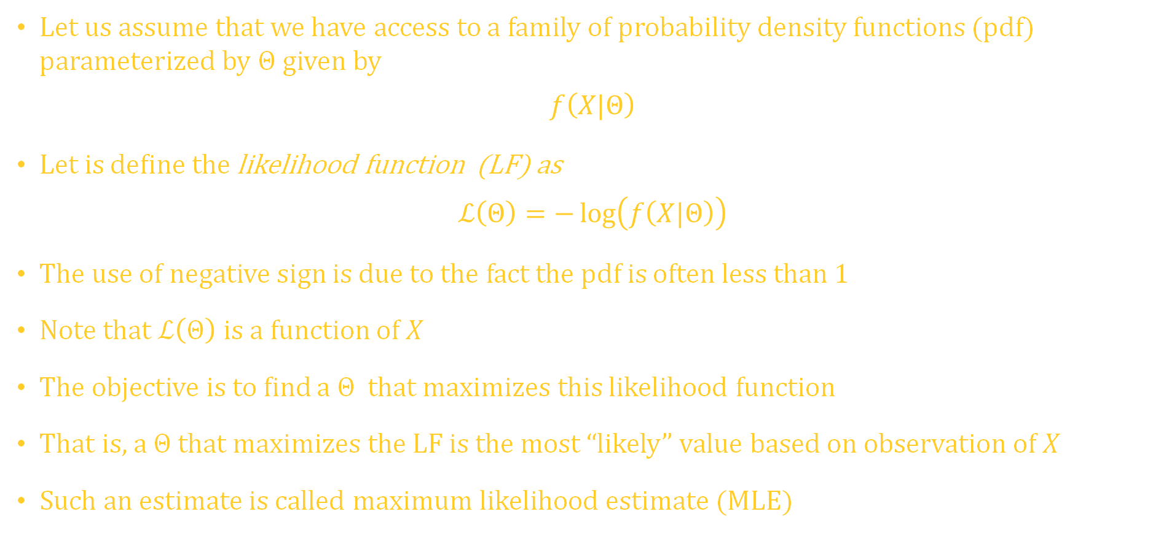
Parameter Estimation
Let us assume that we have access to a family of probability density functions (pdf) parameterized by $Θ$ given by
$$f\left(X|Θ\right)$$
Let is define the likelihood function (LF) as
$$ℒ\left(Θ\right)=−\log\left(f\left(X|Θ\right)\right)$$
The use of negative sign is due to the fact the pdf is often less than 1
Note that $ℒ\left(Θ\right)$ is a function of $X$
The objective is to find a $Θ$ that maximizes this likelihood function
That is, a $Θ$ that maximizes the LF is the most “likely” value based on observation of $X$
Such an estimate is called maximum likelihood estimate (MLE)
Notes:
o

Slide 51
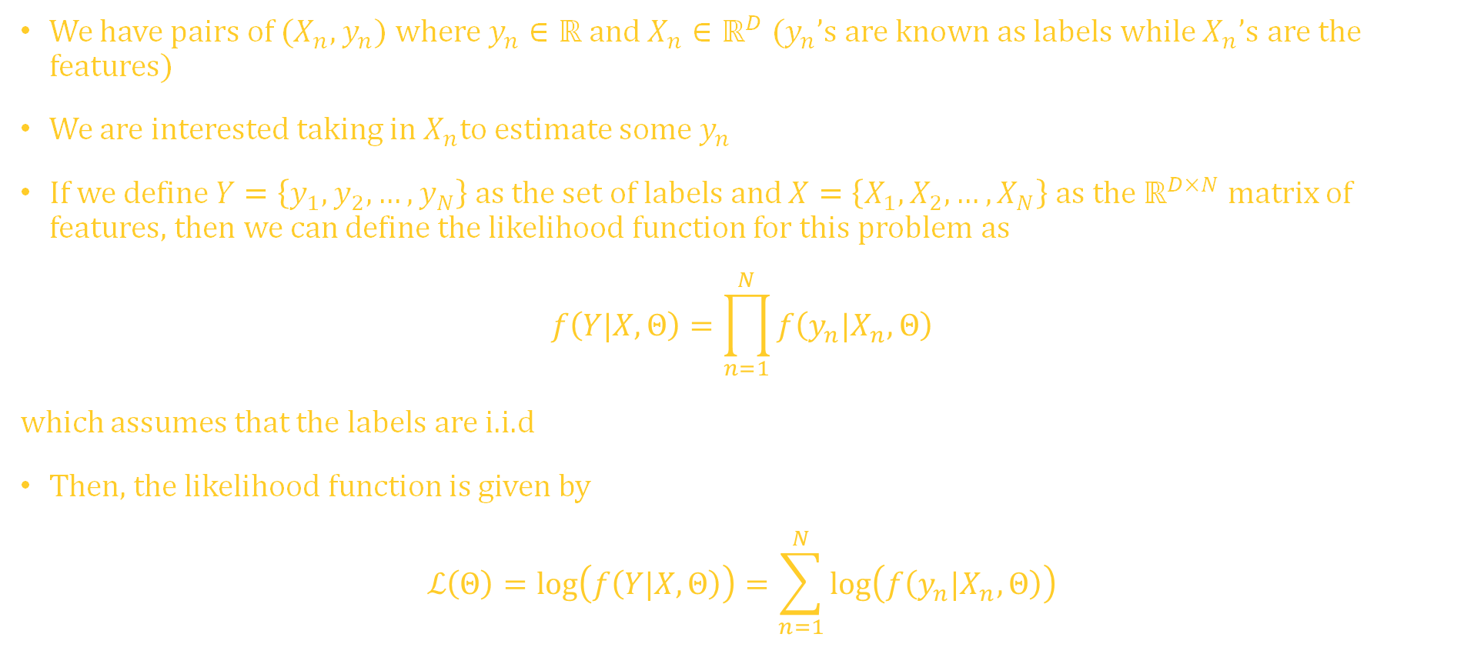
Parameter Estimation (supervised learning example)
We have pairs of $(X_{n},y_{n}$) where $y_{n}∈ℝ$ and $X_{n}∈ℝ^{D}$ ($y_{n}$’s are known as labels while $X_{n}$’s are the features)
We are interested taking in $X_{n}$to estimate some $y_{n}$
If we define $Y=\left\{y_{1},y_{2},…,y_{N}\right\}$ as the set of labels and $X=\left\{X_{1},X_{2},…,X_{N}\right\}$ as the $ℝ^{D×N}$ matrix of features, then we can define the likelihood function for this problem as
$$f\left(Y|X,Θ\right)=\prod_{n=1}^{N}{f\left(y_{n}|X_{n},Θ\right)}$$
which assumes that the labels are i.i.d
Then, the likelihood function is given by
$$ℒ\left(Θ\right)=log\left(f\left(Y|X,Θ\right)\right)=\sum_{n=1}^{N}{log\left(f\left(y_{n}|X_{n},Θ\right)\right)}$$
Notes:
o

Slide 52
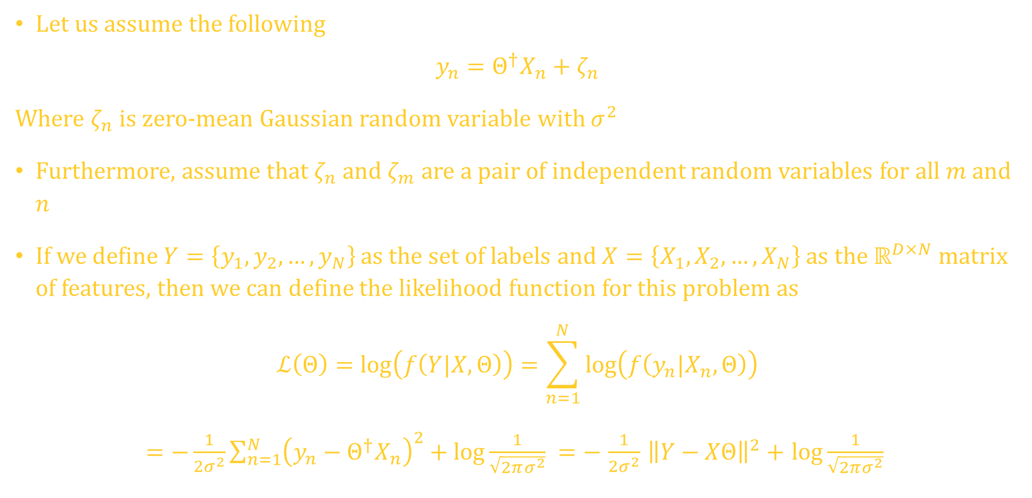
Example
Let us assume the following
$$y_{n}=Θ^{†}X_{n}+ζ_{n}$$
Where $ζ_{n}$ is zero-mean Gaussian random variable with $σ^{2}$
Furthermore, assume that $ζ_{n}$ and $ζ_{m}$ are a pair of independent random variables for all $m$ and $n$
If we define $Y=\left\{y_{1},y_{2},…,y_{N}\right\}$ as the set of labels and $X=\left\{X_{1},X_{2},…,X_{N}\right\}$ as the $ℝ^{D×N}$ matrix of features, then we can define the likelihood function for this problem as
$$ℒ\left(Θ\right)=log\left(f\left(Y|X,Θ\right)\right)=\sum_{n=1}^{N}{log\left(f\left(y_{n}|X_{n},Θ\right)\right)}$$
$=−\frac{1}{2σ^{2}}\sum_{n=1}^{N}{{\left(y_{n}−Θ^{†}X_{n}\right)}^{2}+\log{\frac{1}{\sqrt{2πσ^{2}}} }}=−$ $\frac{1}{2σ^{2}}$ ${\left\|Y−XΘ\right\|}^{2}+$ $\log{\frac{1}{\sqrt{2πσ^{2}}} }$
Notes:
o

Slide 53



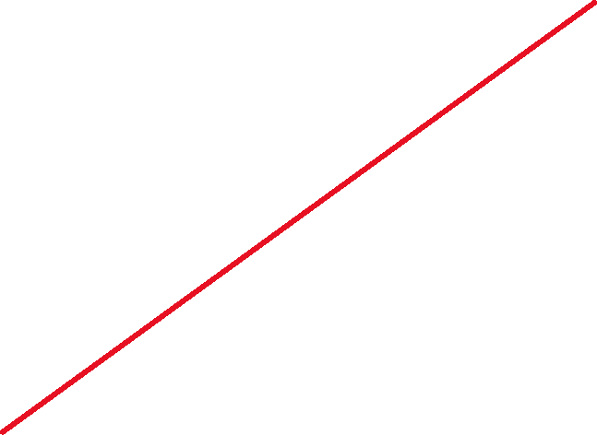
Notes:
o

Slide 54
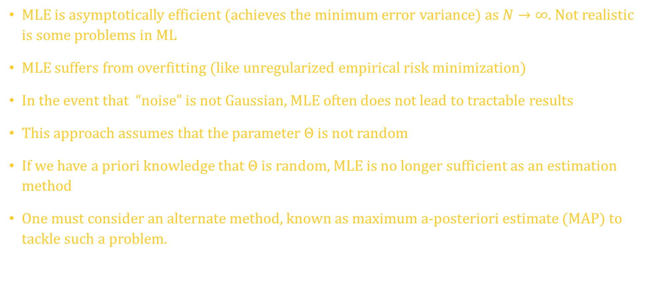
MLE
MLE is asymptotically efficient (achieves the minimum error variance) as $N→∞.$Not realistic is some problems in ML
MLE suffers from overfitting (like unregularized empirical risk minimization)
In the event that “noise” is not Gaussian, MLE often does not lead to tractable results
This approach assumes that the parameter $Θ$ is not random
If we have a priori knowledge that $Θ$ is random, MLE is no longer sufficient as an estimation method
One must consider an alternate method, known as maximum a-posteriori estimate (MAP) to tackle such a problem.
Notes:
o

Slide 55
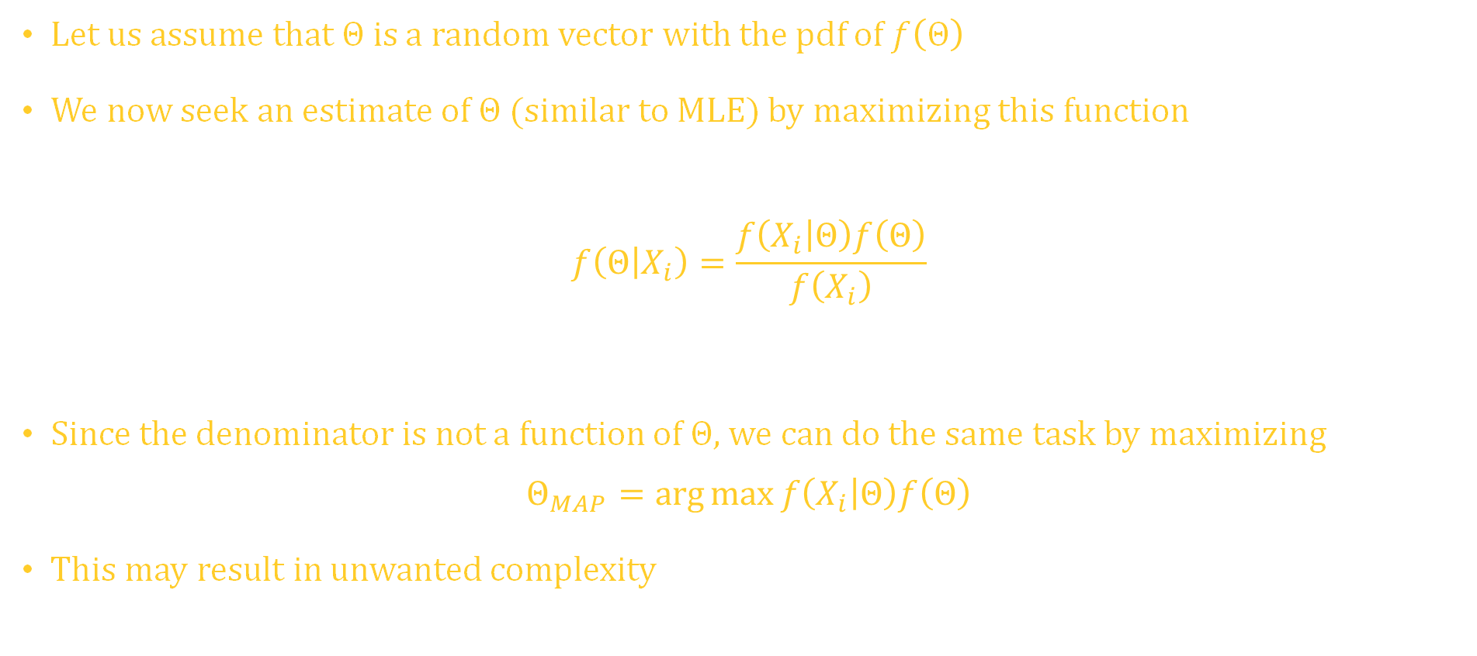
Maximum A Posteriori Estimate
Let us assume that $Θ$is a random vector with the pdf of $f\left(Θ\right)$
We now seek an estimate of $Θ$(similar to MLE) by maximizing this function
$$f\left(Θ | X_{i}\right)=\frac{f\left(X_{i} | Θ\right)f\left(Θ\right)}{f\left(X_{i}\right)}$$
Since the denominator is not a function of $Θ,$we can do the same task by maximizing
$$Θ_{MAP}=\arg{\max{f\left(X_{i} | Θ\right)f\left(Θ\right)}}$$
This may result in unwanted complexity
likeli
hood
prior
posteriori
evidence
Notes:
o

Slide 56
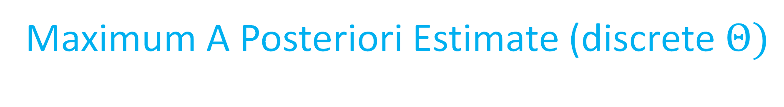
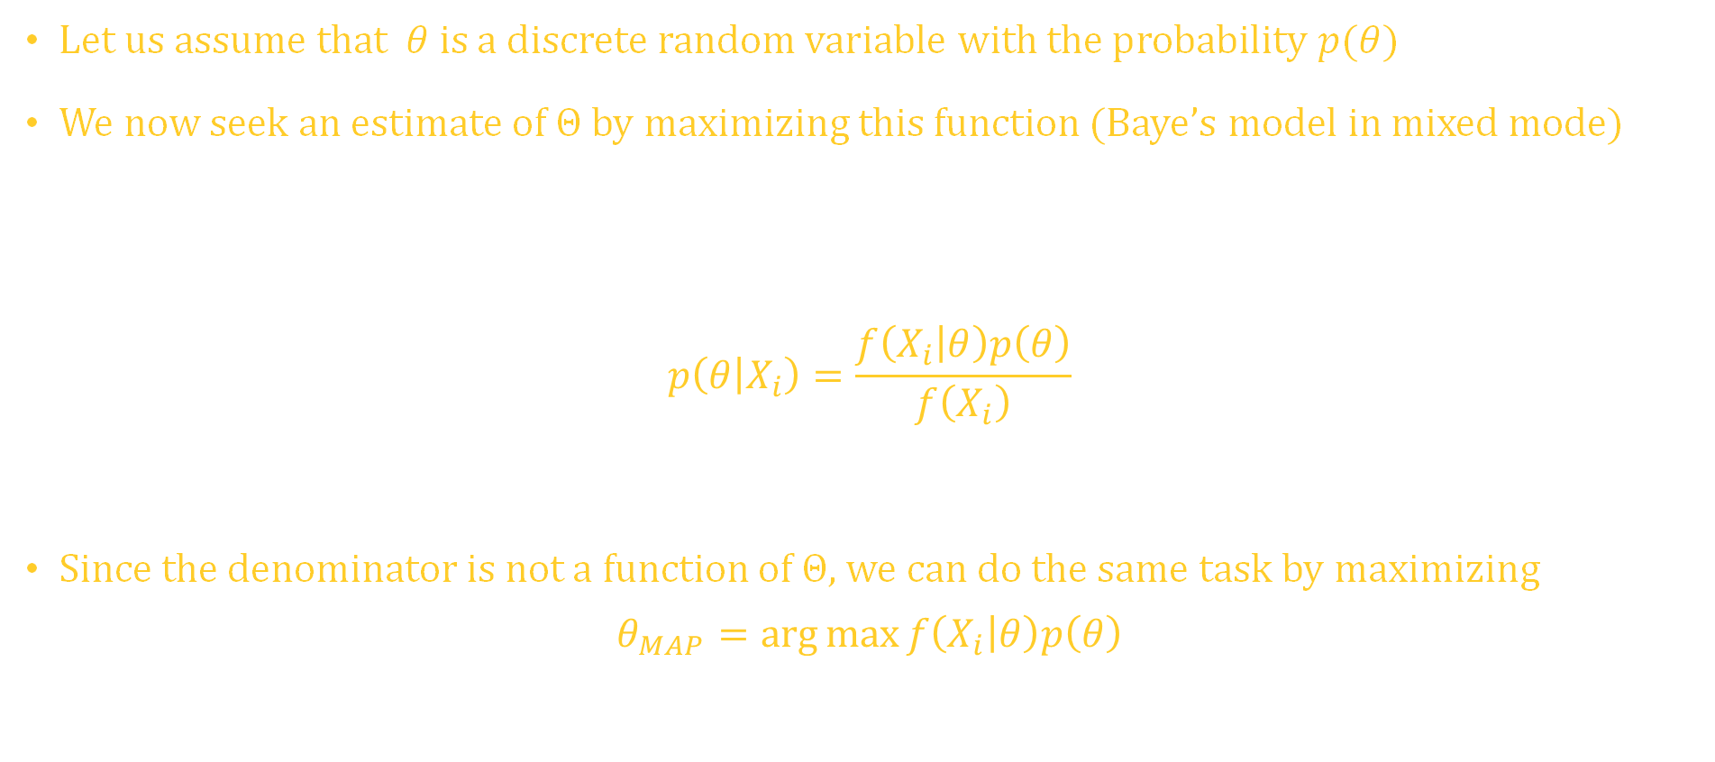
Maximum A Posteriori Estimate (discrete$Θ)$
Let us assume that $θ$is a discrete random variable with the probability $p(θ)$
We now seek an estimate of $Θ$by maximizing this function (Baye’s model in mixed mode)
$$p\left(θ | X_{i}\right)=\frac{f\left(X_{i} | θ\right)p\left(θ\right)}{f\left(X_{i}\right)}$$
Since the denominator is not a function of $Θ,$we can do the same task by maximizing
$$θ_{MAP}=\arg{\max{f\left(X_{i} | θ\right)p\left(θ\right)}}$$
likeli
hood
prior
posteriori
evidence
Notes:
o

Slide 57
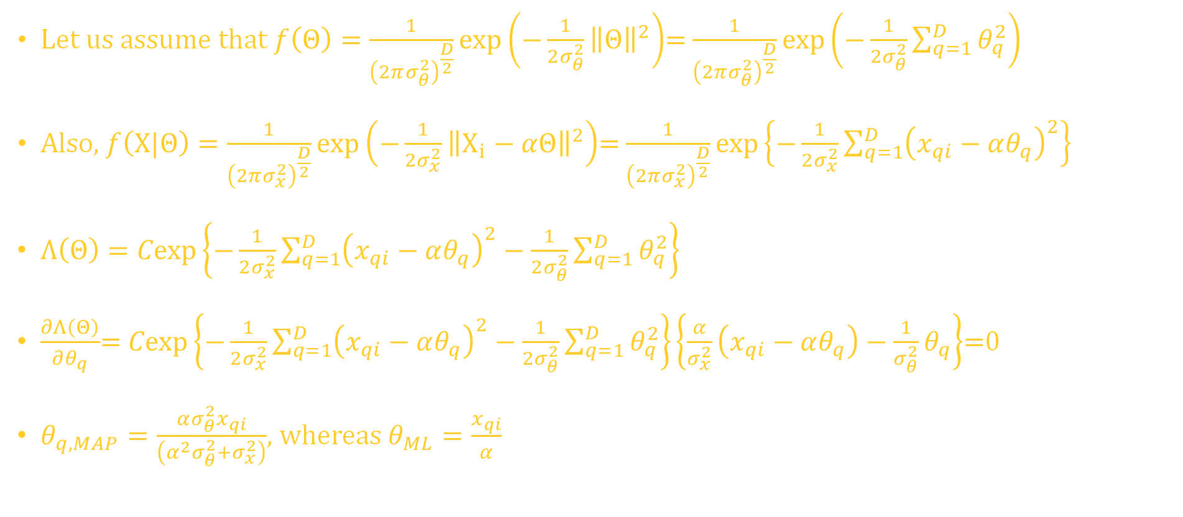
Maximum A Posteriori Estimate (all dimensions at a point in time)
Let us assume that $f\left(Θ\right)=\frac{1}{{\left(2πσ_{θ}^{2}\right)}^{\frac{D}{2}}}exp\left(−\frac{1}{2σ_{θ}^{2}}{\left\|Θ\right\|}^{2}\right)$= $\frac{1}{{\left(2πσ_{θ}^{2}\right)}^{\frac{D}{2}}}exp\left(−\frac{1}{2σ_{θ}^{2}}\sum_{q=1}^{D}{θ_{q}^{2}}\right)$
Also, $f\left(X|Θ\right)=\frac{1}{{\left(2πσ_{x}^{2}\right)}^{\frac{D}{2}}}exp\left(−\frac{1}{2σ_{x}^{2}}{\left\|X_{i}−αΘ\right\|}^{2}\right)$= $\frac{1}{{\left(2πσ_{x}^{2}\right)}^{\frac{D}{2}}}exp\left\{−\frac{1}{2σ_{x}^{2}}\sum_{q=1}^{D}{{\left(x_{qi}−αθ_{q}\right)}^{2}}\right\}$
$Λ\left(Θ\right)=Cexp\left\{−\frac{1}{2σ_{x}^{2}}\sum_{q=1}^{D}{{\left(x_{qi}−αθ_{q}\right)}^{2}}−\frac{1}{2σ_{θ}^{2}}\sum_{q=1}^{D}{θ_{q}^{2}}\right\}$
$\frac{∂Λ\left(Θ\right)}{∂θ_{q}}$= $Cexp\left\{−\frac{1}{2σ_{x}^{2}}\sum_{q=1}^{D}{{\left(x_{qi}−αθ_{q}\right)}^{2}}−\frac{1}{2σ_{θ}^{2}}\sum_{q=1}^{D}{θ_{q}^{2}}\right\}\left\{\frac{α}{σ_{x}^{2}}\left(x_{qi}−αθ_{q}\right)−\frac{1}{σ_{θ}^{2}}θ_{q}\right\}$=0
$θ_{q,MAP}=\frac{ασ_{θ}^{2}x_{qi}}{\left(α^{2}σ_{θ}^{2}+σ_{x}^{2}\right)}$, whereas $θ_{ML}=\frac{x_{qi}}{α}$
Notes:
o

Slide 58
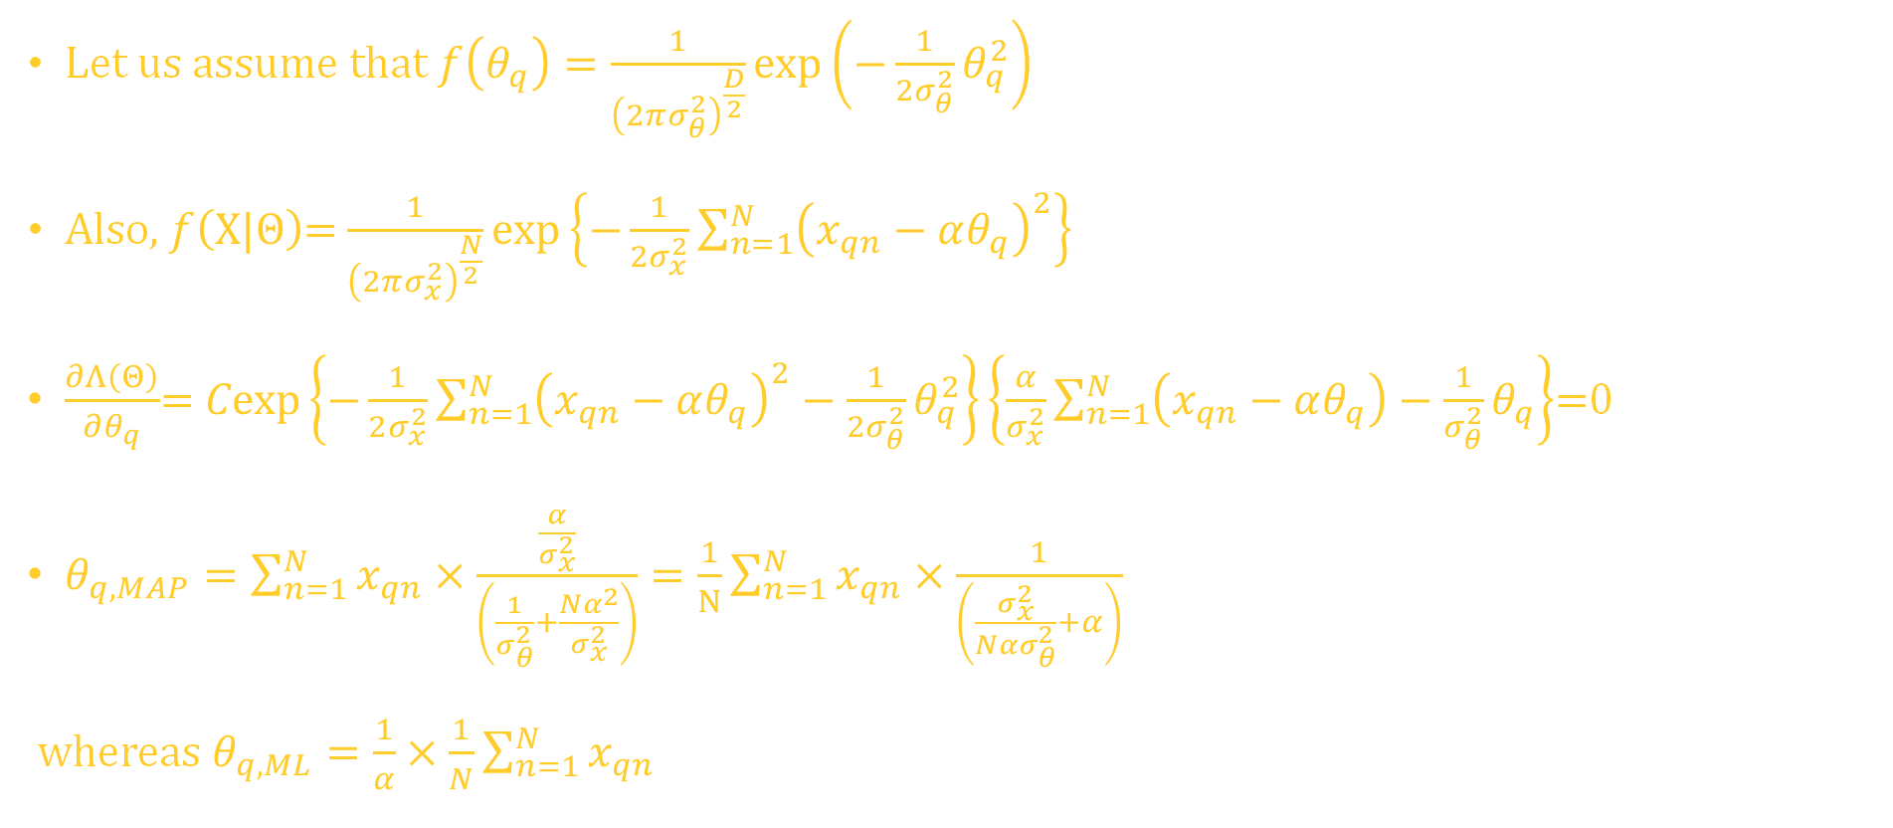
Maximum A Posteriori Estimate (only one dimension over time)
Let us assume that $f\left(θ_{q}\right)=\frac{1}{{\left(2πσ_{θ}^{2}\right)}^{\frac{D}{2}}}exp\left(−\frac{1}{2σ_{θ}^{2}}θ_{q}^{2}\right)$
Also, $f\left(X|Θ\right)$= $\frac{1}{{\left(2πσ_{x}^{2}\right)}^{\frac{N}{2}}}exp\left\{−\frac{1}{2σ_{x}^{2}}\sum_{n=1}^{N}{{\left(x_{qn}−αθ_{q}\right)}^{2}}\right\}$
$\frac{∂Λ\left(Θ\right)}{∂θ_{q}}$= $Cexp\left\{−\frac{1}{2σ_{x}^{2}}\sum_{n=1}^{N}{{\left(x_{qn}−αθ_{q}\right)}^{2}}−\frac{1}{2σ_{θ}^{2}}θ_{q}^{2}\right\}\left\{\frac{α}{σ_{x}^{2}}\sum_{n=1}^{N}{\left(x_{qn}−αθ_{q}\right)}−\frac{1}{σ_{θ}^{2}}θ_{q}\right\}$=0
$θ_{q,MAP}=\sum_{n=1}^{N}{x_{qn}}×\frac{\frac{α}{σ_{x}^{2}}}{\left(\frac{1}{σ_{θ}^{2}}+\frac{Nα^{2}}{σ_{x}^{2}}\right)}=\frac{1}{N}\sum_{n=1}^{N}{x_{qn}}×\frac{1}{\left(\frac{σ_{x}^{2}}{Nασ_{θ}^{2}}+α\right)}$
whereas $θ_{q,ML}=\frac{1}{α}×\frac{1}{N}\sum_{n=1}^{N}{x_{qn}}$
Notes:
o

Slide 59
Parametric Density Estimation
What we have observed so far allows one to estimate the parameters (mean, variance, etc.) of a known pdf
This requires one to have a priori information about the pdf (that is, the pdf is Gaussian, for instance) in order to estimate its relevant parameters
Gaussian pdfs are in general very attractive as they rely on only two parameters, mean and the variance, to be fully characterized (2nd order processes)
Furthermore, central limit theorem states that if our observation can be modeled as the sum of many independent and identically distributed (i.i.d) random variables, the resulting random variable can be modeled as Gaussian
For instance, if we sum many coin toss results (heads +1 , tails -1) and normalize it to the total number of tosses, the resulting random variable resembles a Gaussian-distributed random variable
Notes:
o

Slide 60
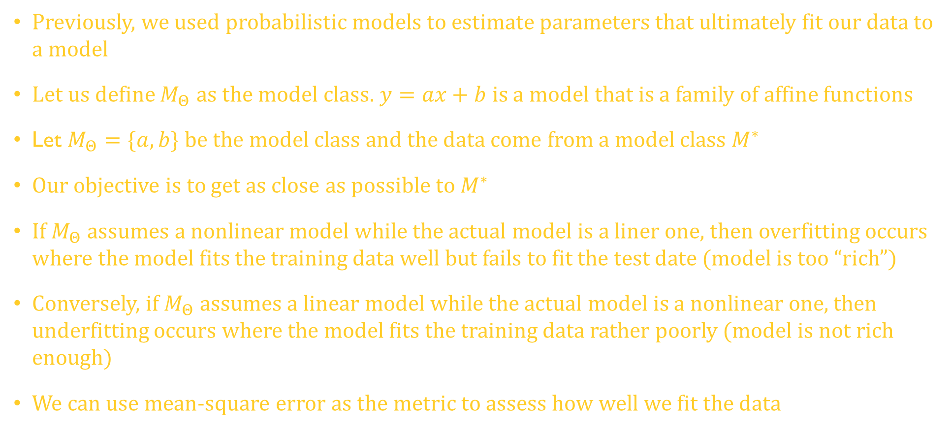
Model Fitting-overfitting, underfitting, rich enough!
Previously, we used probabilistic models to estimate parameters that ultimately fit our data to a model
Let us define $M_{Θ}$ as the model class. $y=ax+b$ is a model that is a family of affine functions
Let $M_{Θ}=\{a,b\}$ be the model class and the data come from a model class $M^{∗}$
Our objective is to get as close as possible to $M^{∗}$
If $M_{Θ}$ assumes a nonlinear model while the actual model is a liner one, then overfitting occurs where the model fits the training data well but fails to fit the test date (model is too “rich”)
Conversely, if $M_{Θ}$ assumes a linear model while the actual model is a nonlinear one, then underfitting occurs where the model fits the training data rather poorly (model is not rich enough)
We can use mean-square error as the metric to assess how well we fit the data
Notes:
o

Slide 61



Model Fitting-overfitting, underfitting, rich enough!
overfitting
underfitting
Rich enough
Notes:
o

Slide 62
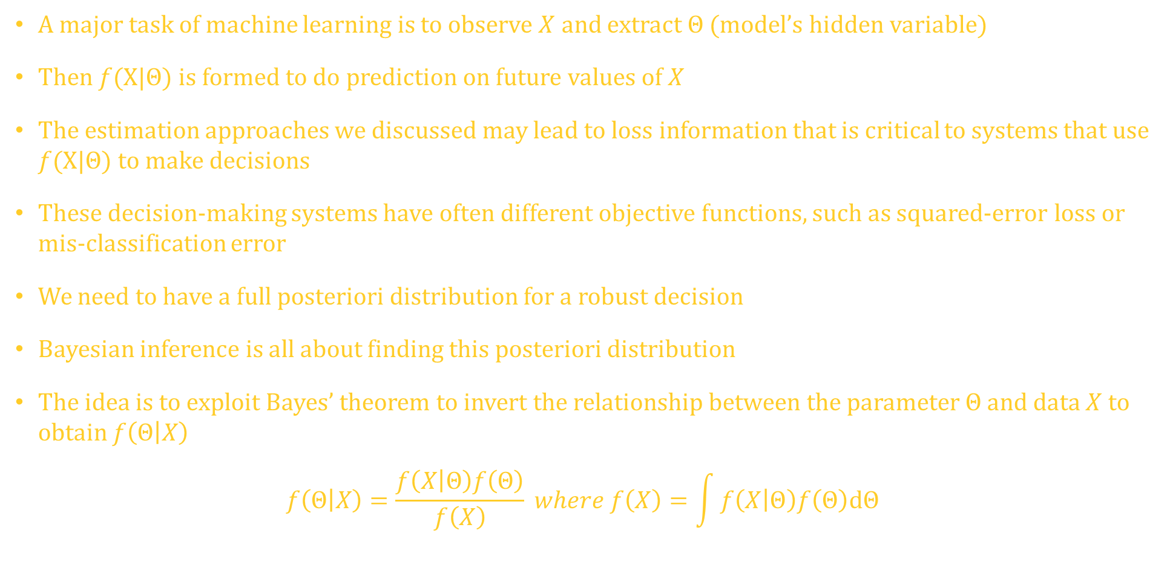
Probabilistic models-Bayesian inference
A major task of machine learning is to observe $X$ and extract $Θ$ (model’s hidden variable)
Then $f(X|Θ)$ is formed to do prediction on future values of $X$
The estimation approaches we discussed may lead to loss information that is critical to systems that use $f(X|Θ)$ to make decisions
These decision-making systems have often different objective functions, such as squared-error loss or mis-classification error
We need to have a full posteriori distribution for a robust decision
Bayesian inference is all about finding this posteriori distribution
The idea is to exploit Bayes’ theorem to invert the relationship between the parameter $Θ$and data $X$ to obtain $f\left(Θ | X\right)$
$$f\left(Θ | X\right)=\frac{f\left(X | Θ\right)f\left(Θ\right)}{f\left(X\right)} where f\left(X\right)=\int{f\left(X | Θ\right)f\left(Θ\right)dΘ}$$
Notes:
o

Slide 63

Probabilistic models-Bayesian inference
This implies that this posteriori pdf can be used to propagate uncertainty from parameters to data
Given a $f(Θ)$, our prediction will be
$$f\left(X\right)=\int{f\left(Θ | X\right)f\left(Θ\right)dΘ}$$
where integral is over all possible values $Θ$ ($D$ dimensional integral)
Now, the prediction no longer depends on $Θ$ as it has been integrated out
The prediction is an average over all plausible parameter values $Θ$, where the plausibility is encapsulated by the parameter distribution $f(Θ)$
Notes:
o

Slide 64

Probabilistic models-Bayesian inference
There are two approaches that we have discussed. In one, an estimate of $Θ$ is obtained using ML or MAP. Such an estimate can be used now to optimize our solution
The other approach is to compute the posteriori pdf. The difficulty is the integration that is involved.
The 2nd approach (Bayesian inference) has several advantages:
1) Principled way to incorporate prior knowledge
2) Accounting for side information
3) Incorporating structural knowledge
Finally, the propagation of the parameter uncertainty to the prediction can be valuable in decision-making systems for risk assessment and exploration in the context of data-driven learning
Notes:
o

Slide 65

Bayesian Model Selection
There are many model selection techniques that are selected by compromising complexity for data fit (performance)
Less complex models (surprisingly) are less prone to overfitting
Objective is to come up with the simplest model that explains data reasonably well- Occam’s Razor
Let us assume that we have finite number of models $M=\left\{M_{1},M_{2},…,M_{k}\right\}$
$M_{k}⇔Θ_{k}⇔f\left(Θ_{k}\right).$Also, $DATA$ denotes the data set. We now have
$$p(M_{k}|DATA)∝p\left(M_{k}\right)f(DATA|M_{k})$$
$$f\left(DATA | M_{k}\right)=\int{f\left(DATA | Θ_{k}\right)p\left(Θ_{k} | M_{k}\right)dΘ_{k}}$$
This expression is called model evidence or marginal likelihood (different from likelihood)
Notes:
o

Slide 66

Bayesian Model Selection
Then, the MAP estimate is given by
$$M^{∗}=\arg{\max_{M_{k}}{p(M_{k}|DATA)}}$$
For equally like case ($p\left(M_{k}\right)=\frac{1}{k}),$ the MAP estimate is obtained by maximizing the model evidence $f(DATA|M_{k})$
We can then introduce Baye’s factor for model selection (assume $k=2)$
$$\frac{p\left(M_{1} | DATA\right)}{p\left(M_{2} | DATA\right)}=\frac{\frac{f\left(DATA | M_{1}\right)p\left(M_{1}\right)}{f\left(DATA\right)}}{\frac{f\left(DATA | M_{2}\right)p\left(M_{2}\right)}{f\left(DATA\right)}}=\frac{p\left(M_{1}\right)}{p\left(M_{2}\right)}×\frac{f\left(DATA | M_{1}\right)}{f\left(DATA | M_{2}\right)}$$
Baye's
prior
odds
factor
Notes:
o

Slide 67

Bayesian Model Selection
Jeffreys-Lindley paradox states that the Baye’s factor always favors the simpler model since the probability of data under a complex model with a diffused prior will be very small
A diffused prior refers to a prior that does not favor specific models (that is, many models are a prior plausible under this prior)
If priors are uniform, then we only need to consider Baye’s factor $\frac{f\left(DATA | M_{1}\right)}{f\left(DATA | M_{2}\right)}$
If Baye’s factor is greater than 1, we choose $M_{1}.$ Otherwise, we choose $M_{2}$
The approach requires that we compute $f\left(DATA | M_{k}\right)=\int{f\left(DATA | Θ_{k}\right)p\left(Θ_{k} | M_{k}\right)dΘ_{k}}$, which in many problems is not tractable
In the context of linear regression (will be covered later), we have a case with conjugate a prior that one can solve this integral
A prior is conjugate for the likelihood function if the posteriori is of the same form/type as the prior
Notes:
o

Slide 68

Linear Regression
Problem: We have $X_{n}∈ℝ^{D}$ and we want to find g$(X_{n})$ that maps $X_{n}$ onto $ℝ$
We assume that we have been given a set of inputs $X_{n}$ and outputs $y_{n}=g\left(X_{n}\right)+ε_{n}$
$ε_{n}$ describes measurement/observation noise and unmodeled processes
We assume that this parameter is a zero-mean Gaussian noise
We need to address the following problems
Choice of the model (type) and the parametrization (should we use a polynomial and if so, what should be the order?)
Finding good parameters (how do we find a good model parameter). We need to consider various loss/objective functions
Overfitting and model selection (we match very too well with training data and not so well for the test data)
Relationship between loss functions and parameter priors (loss functions are often motivated and induced by probabilistic models, which are related to prior statistics)
Underlying modeling (dealing with finite data for training and ensuing uncertainly)
Notes:
o

Slide 69

Linear Regression
Formulation: $f\left(y | X\right)=ℕ(g(X),σ^{2})$; $X∈ℝ^{D}$ and $ℕ(m,σ^{2})$denotes a normal random distribution with mean $m$and variance $σ^{2}$
g$\left(X\right)=X^{T}Θ$ where $Θ∈ℝ^{D}$ (linear model)-We intend to find $Θ$
$f\left(y | X,Θ\right)=ℕ\left(X^{T}Θ,σ^{2}\right)$ is the likelihood function
Our task becomes to estimate $Θ$ that maximized the likelihood function (deja vu)
Let $D≔\{\left(X_{1},y_{1}\right),…,\left(X_{N},y_{N}\right)\}$
$f\left(Y | X,Θ\right)=\prod_{n=1}^{N}{ℕ(X_{n}^{T}Θ,σ^{2})\text{;}}$ (independent observations, which is due to $ε_{n}^{′}s)$. Now,
$$Θ_{ML}∈\arg{\max_{Θ}{f(Y|X,Θ)}}$$
One can use gradient ascent (or descent if negative likelihood function is used) to arrive at the solution
In this case (linear regression), a closed form solution exists
Notes:
o

Slide 70

Linear Regression
$L\left(Θ\right)=−\log{f\left(Y | X,Θ\right)}=\sum_{n=1}^{N}{\log{f\left(y_{n}\right|X_{n},Θ)}}=\frac{1}{2σ^{2}}{\left(y_{n}−X_{n}^{T}Θ\right)}^{2}+constant$
$−\log{f\left(Y | X,Θ\right)}=\frac{1}{2σ^{2}}\left\|{\left.Y−XΘ\right\|}^{2}\right.$; where $X={\left[X_{1},…,X_{N}\right]}^{T}$ (${X∈ℝ}^{N×D}$)
$\frac{d}{dΘ}L\left(θ\right)=\frac{1}{2σ^{2}}\frac{d}{dΘ}\left(Y^{T}Y−2Y^{T}XΘ+Θ^{T}X^{T}XΘ\right)=\frac{1}{σ^{2}}\left(−Y^{T}X+Θ^{T}X^{T}X\right)∈ℝ^{1×D}$
$\frac{d}{dΘ}L\left(θ\right)=0⇒Θ_{ML}^{T}X^{T}X=Y^{T}X$
$Θ_{ML}^{T}=Y^{T}X{\left(X^{T}X\right)}^{−1}⇒Θ_{ML}={\left(X^{T}X\right)}^{−1}X^{T}Y$ note that $X^{T}X∈D×D$ matrix
Given that $Y∈ℝ^{N},$ then $Θ_{ML}∈ℝ^{D}$ (we saw this before under LSQ case)
Notes:
o

Slide 71

MLE with features
Linear model regression we have discussed may not be sufficient when we encounter a certain class of data
However, LR offers us a way of fitting nonlinear functions within the linear regression framework
That is, we can define nonlinear functions to formulate the problem
$f\left(y | X,Θ\right)=ℕ\left(φ^{T}(X)Θ,σ^{2}\right)⇒y_{n}=φ^{T}\left(X_{n}\right)Θ+ε_{n}$ where $φ:ℝ^{D}→ℝ^{K}$ and $Θ∈ℝ^{K}$ for some $K$
Note that the model is still linear in $Θ$ but not in $X$
Example: Let us a define $φ(X)$ as (one dimensional input)
$$φ\left(x\right)=\left[\begin{aligned}\begin{matrix}1 \\ x \\ x^{2}\end{matrix} \\ ⋮ \\ x^{K−1}\end{aligned}\right]∈ℝ^{K}$$
Notes:
o

Slide 72

MLE with features
$$φ\left(x\right)=\left[\begin{aligned}\begin{matrix}1 \\ x \\ x^{2}\end{matrix} \\ ⋮ \\ x^{K−1}\end{aligned}\right]∈ℝ^{K}$$
This implies we map a one-dimensional input space into $K$ dimensional feature space
Note that $y=\sum_{k=0}^{K−1}{θ_{k}x^{k}}+ε$ where now $Θ=\left[\begin{aligned}\begin{matrix}θ_{0} \\ θ_{1} \\ θ_{2}\end{matrix} \\ ⋮ \\ θ_{K−1}\end{aligned}\right]$ $∈ℝ^{K}$
Now, let us address the MLE when we are dealing with an input that is a vector
Notes:
o

Slide 73

MLE with features
In this case, $X_{n}$ is training input vectors, $y_{n}$ is target, and the feature matrix (design matrix) is
$Φ\left(X\right)=\left[\begin{matrix}φ_{0}(X_{1}) & ⋯ & φ_{K−1}\left(X_{1}\right) \\ ⋮ & ⋱ & ⋮ \\ φ_{0}\left(X_{N}\right) & ⋯ & φ_{K−1}\left(X_{N}\right)\end{matrix}\right]∈ℝ^{N×K}$ where
$$φ_{j}\left(X\right) performs ℝ^{D}→ℝ$$
For $D=1, φ_{j}\left(x\right)=x^{j}$. In that case,
$Φ\left(X\right)=\left[\begin{matrix}1 & ⋯ & x_{1}^{K−1} \\ ⋮ & ⋱ & ⋮ \\ 1 & ⋯ & x_{N}^{K−1}\end{matrix}\right]$ $∈ℝ^{N×K}$
In general, we have
$Y=Φ(X)Θ+Ε$ where $Ε=\left[\begin{aligned}\begin{matrix}ε_{1} \\ ε_{2} \\ ε_{3}\end{matrix} \\ ⋮ \\ ε_{N}\end{aligned}\right]$
Notes:
o

Slide 74

MLE with features
Now,
$−\log{f\left(Y | X,Θ\right)=\frac{1}{2σ^{2}}{\left(Y−ΦΘ\right)}^{T}\left(Y−ΦΘ\right)+}$ constant
$$Θ_{ML}={\left(Φ^{T}Φ\right)}^{−1}Φ^{T}Y$$
Example: Let us consider a single dimension problem ($D=1)$ where the training data is $x_{n}∈[−4,−3,−2,−1,0,1,2,3,4,5]$ ($N=10).$
$y_{n}=−\sin\left(\frac{x_{n}}{5}\right)+\cos\left(x_{n}\right)+ε_{n}$
where $ε_{n}=ℕ(0,0.04)$. We are interested in finding the MLE for the case of a polynomial fitting of degree 4.
That is, we are looking for $Θ$ such that
$$Y=ΦΘ_{ML}$$
Notes:
o

Slide 75

MLE with features
Where
$$Φ=\left[\begin{matrix}1 & ⋯ & x_{1}^{4} \\ ⋮ & ⋱ & ⋮ \\ 1 & ⋯ & x_{10}^{4}\end{matrix}\right]∈ℝ^{10×5}$$
$Y=[−1.7987, −1.7226, −0.5346, 0.1272,1.1922,0.7638,0.2606,−0.8175,0.0242,0.8836]$
The, using $Θ_{ML}={\left(Φ^{T}Φ\right)}^{−1}Φ^{T}Y$,
$$Θ_{ML}=\left[\begin{matrix}\text{0.8763} \\ \text{0.2405} \\ \begin{aligned}\text{−0.3136} \\ \text{−}\text{0.0041} \\ \text{0.0117}\end{aligned}\end{matrix}\right]$$
We have plotted $y_{n}$ and the MLE ($Y=ΦΘ_{ML})$in the figure below
Notes:
o

Slide 76

MLE with features
Notes:
o

Slide 77

MLE with features
The previous analysis assumed a knowledge of $σ^{2}$ (although the calculation of $Θ_{ML} did not depend on σ^{2})$. If that information is not known, then we can estimate it
$$\log{f\left(y | X,Θ,σ^{2}\right)}=−\frac{N}{2}\log{σ^{2}}−\frac{1}{2σ^{2}}\sum_{n=1}^{N}{{\left(y_{n}−φ^{T}\left(x_{n}\right)Θ\right)}^{2}+const}$$
$$\frac{∂\log{f\left(y | X,Θ,σ^{2}\right)}}{∂σ^{2}}=−\frac{N}{{2σ}^{2}}+\frac{1}{{2σ}^{4}}\sum_{n=1}^{N}{{\left(y_{n}−φ^{T}\left(x_{n}\right)Θ\right)}^{2}}$$
$\frac{∂\log{f\left(y | X,Θ,σ^{2}\right)}}{∂σ^{2}}$=0
$$σ_{ML}^{2}=\frac{1}{N}\sum_{n=1}^{N}{{\left(y_{n}−φ^{T}\left(x_{n}\right)Θ\right)}^{2}}$$
Notes:
o

Slide 78

MAP LR
Similar to ML, we can set up MAP estimate assuming that $Θ$is random with a given pdf
$$Θ_{MAP}=\arg{\max_{Θ}\left\{\log{f\left(Y|X,Θ)+\log\left(f(Θ\right)\right)}\right\}}$$
Assuming $f\left(Θ\right)=ℕ(0,b^{2} I)$ where $I$ is a $K×K$ identity
$∇\left\{\log{f\left(Y|X,Θ)+\log\left(f(Θ\right)\right)}\right\}$=0
$$Θ_{MAP}={\left(Φ^{T}Φ+\frac{σ^{2}}{b^{2}}I\right)}^{−1}Φ^{T}Y$$
Note that the only difference between $Θ_{MAP}$ and its counterpart $Θ_{ML}$ seems to be the presence of $\frac{σ^{2}}{b^{2}}I$. This oversimplification is due to the assumption that parameter $Θ$ is a Gaussian random vector with independent elements
Any deviation from this assumption will result in considerable complication in computing $Θ_{MAP}$
Notes:
o

Slide 79

MAP and MLE/Bayesian Inference
As we discussed previously, both MLE and MAP suffer from overfitting where the match to target is quite reasonable over the training data while the test data yields unacceptably high mean-square error
We discussed methods (regularization) to overcome such scenarios
The other method is to use Bayesian linear regression (Bayesian inference)
Prior Prediction
This method does not try to estimate the parameter. Instead, the full posteriori distribution over the parameters is taken into account when making prediction
Model $\left\{\begin{aligned}f\left(Θ\right)=ℕ(m_{0},S_{0}) \\ f\left(Y | X,Θ\right)=ℕ(Y|Φ^{T}Θ,σ^{2})\end{aligned}\right.⇒f\left(Y,Θ|X\right)=f\left(Y | X,Θ\right)f(Θ)$ ($Θ and X$ are independent)
To make prediction ($Y)$ given $X$, we average over $Θ$
$$f\left(Y | X\right)=\int{f\left(Y,Θ|X\right)dΘ=\int{f\left(Y|X,Θ\right)f(Θ)dΘ}=E_{Θ}}\left\{f\left(Y|X,Θ\right)\right\}$$
Which can be interpreted as the average prediction of $Y |X,Θ$ for all plausible parameters $Θ$ according to the distribution $f(Θ)$
Notes:
o

Slide 80

Bayesian Inference
Given this formulation, $Y$ is conditionally Gaussian when conditioned on $X$
$$f\left(Y | X\right)=ℕ\left(Φ^{T}\left(X\right)m_{0},Φ^{T}\left(X\right)S_{0}Φ\left(X\right)+σ^{2}\right)$$
Note that prediction using the prior distribution only requires us to specify X, but no training data
Now, we can find the pdf of $Y$ (prediction) given an input $X$ without resorting to the estimation of any parameters
Notes:
o

Slide 81


Logistic Regression
Linear regression was used for prediction and classification
For the case of binary classification (only two possible class of outcomes), one can use logistic regression
Let us define the logistic function $σ\left(y\right)=\frac{1}{1−e^{−y}}$
Note that $σ\left(−z\right)=1−σ(z)$
As we saw in the regression problem, we obtained
$Θ$, which allowed us to express $Y=Θ^{T}X$
Since this is a linear combination, $y_{n}$ can assume any
Value (even negative values)
Notes:
o

Slide 82

Logistic Regression
For the case where $y_{n}$ is binary (1 or 0), we are interested in computing $p\left(y_{n}=1 | X\right)$ and $p\left(y_{n}=0 | X\right)$
However, the output of LS assumes a large range of values
Using the sigmoid (the logistic function), we can limit the output to a number between 1 and 0 (a legitime probability)
$p\left(y_{n}=1\right)=σ\left(y_{n}\right)$ and $p\left(y_{n}=0\right)=1−σ\left(y_{n}\right)=σ(−y_{n})$
We refer to the input of sigmoid function as logit
$$logit\left(p\right)=\ln{\frac{p}{1−p}}$$
Hence, we have $decision x=\left\{\begin{aligned}1, p\left(y=1 | x\right)≥0.5 \\ 0, othwerwise \end{aligned}\right.$
Notes:
Oif

Slide 83

Density Estimation and Gaussian Mixture model (DE-GMM)
Notes:
o

Slide 84

DE-GMM
Let us define a pdf that is a convex combination of $K$ simple (base) distribution
$f\left(X_{n}\right)=\sum_{k=1}^{K}{π_{k}f_{k}(X_{n})}$ where $\sum_{k=1}^{K}{π_{k}}=1$ and ${0≤π}_{k}≤1 for all k$
$f_{k}{(X_{n})}^{′}s$all belong to the same family (Gaussian, Gamma, Bernoulli, etc.)
Note that if $f_{k}(X)$ are all Gaussian, $f(X)$ will not be Gaussian!
We will focus on GMM
So, we now have
$$f\left(X_{n} | Θ\right)=\sum_{k=1}^{K}{π_{k}ℕ\left(X_{n}|μ_{k},Σ_{k}\right)}$$
$$Θ≔\left\{μ_{k},μ_{k},Σ_{k};k=1:K \right\}$$
Where $Σ_{k}$ is the covariance matrix of $X$for the $k$th sample distribution ($D×D)$
Notes:
o

Slide 85


DE-GMM
Here is an example of $K=2, D=1$, $μ_{1}=−5, μ_{2}=6, σ_{1}=1, σ_{2}=0.5,π_{1}=0.3, and π_{2}=0.7,$ which means
$$f\left(x\right)=\frac{0.3}{\sqrt{2{πσ}_{1}^{2}}}exp\left\{\frac{1}{2σ_{1}^{2}}{\left(x+5\right)}^{2}\right\}+\frac{0.7}{\sqrt{2{πσ}_{2}^{2}}}exp\left\{\frac{1}{2σ_{2}^{2}}{\left(x−6\right)}^{2}\right\}$$
Notes:
o

Slide 86

DE-GMM
So, our task is to estimate the relevant parameters from the test data
We use what we have learned before (MLE) to obtain the necessary parameter and a means of updating them. Assume we have training vector $X=\left[X_{1},X_{2},…,X_{N}\right]$
$$f\left(X | Θ\right)=\prod_{n=1}^{N}{f\left(X_{n} | Θ\right)=\prod_{n=1}^{N}{\sum_{k=1}^{K}{π_{k}ℕ\left(X_{n}|μ_{k},σ_{k}^{2} \right)}}}$$
$$χ=log{f\left(X | Θ\right)}=\sum_{n=1}^{N}{\log\left\{\sum_{k=1}^{K}{π_{k}ℕ\left(X_{n}|μ_{k},Σ_{k} \right)}\right\}}$$
$$\log{ℕ\left(X_{n} | μ_{k},Σ_{k}\right)=−\frac{D}{2}\log{2π−\frac{1}{2}\log{\det\left(Σ_{k}\right)−\frac{1}{2}{\left(X_{n}−μ_{k}\right)}^{T}Σ_{k}^{−1}(X_{n}−μ_{k})}}}$$
We now must obtain $\frac{∂χ}{∂μ_{k}}=0^{T}(D×1)$, $\frac{∂χ}{∂Σ_{k}}=0 (D×D)$, $\frac{∂χ}{∂π_{k}}=0$
Notes:
o

Slide 87

DE-GMM
Before doing so, let us define “Responsibilities”
$r_{n,k}=\frac{π_{k}ℕ\left(X_{n} | μ_{k},Σ_{k}\right)}{\sum_{j=1}^{K}{π_{j}ℕ\left(X_{n} | μ_{j},Σ_{j}\right)}}$;
$\sum_{k=1}^{K}{r_{n,k}}=1$;${ R}_{n}={\left[r_{1,k},r_{2,k},…,r_{N,k}\right]}^{T}$
Note that “Responsibilities” cannot be evaluated without the parameters we are seeking!
Based on this metric, we can find a means of iterating estimated of the other parameters
That is,
$$μ_{k,new }=\frac{\sum_{n=1}^{N}{r_{n,k}X_{n}}}{N_{k}}\text{;} where N_{k}=\sum_{n=1}^{N}{r_{n,k}}$$
$$Σ_{k,new}=\frac{1}{N_{k}}\sum_{n=1}^{N}{r_{n,k}}\left(X_{n}−μ_{k}\right) {\left(X_{n}−μ_{k}\right)}^{T}$$
$π_{k,new}=\frac{N_{k}}{N}$ where $N$ is the number of data points
Notes:
o

Slide 88

Expectation Maximization (EM)
Although the previous discussion seems odd, it offers us an iterative solution to finding the MLE of the parameters we are trying to find. This leads to an algorithm known as the expectation maximization
Initialize $π_{k}, μ_{k},$ and $Σ_{k}$ (initial guess)
E-step. Compute $r_{n,k}$ for every $n ({that is for every X}_{n})$
M-step. Re-estimate the parameters using the equations above
Repeat this algorithm until convergence is achieved
We can check for convergence by checking the log-likelihood function (achieves a maximum) or the parameters directly (iteration converges)
Also, this method offers a mechanism by which the previous dataset can be used to update estimates of the parameter for the current dataset (this is important for dynamic cases).
$$We start with X^{(1)}=\left[X_{1},X_{2},…,X_{N}\right] now we have{ X}^{(2)}=\left[X_{N+1},X_{N+2},…,X_{2N}\right]$$
Notes:
o

Slide 89
Continuous Optimization
In machine learning world, training is the key
Training boils down to finding a set of “good” parameters
The notion of “good” is determined by an objective function or a probabilistic model
Given an objective function, the best value is obtained using optimization algorithms
In machine learning, most objective functions are differentiable
The idea is to find a minimum of objective function in an unconstrained manner or constrained manner
Some algorithms will reach local minima
We will talk about convex optimization where we have a chance of reaching global optimum solution
Notes:
o

Slide 90

Optimization using gradient descent
When we are dealing with unconstrained optimization, we use gradient descent to arrive at the of the objective function
$\min_{X}{g(X)}$ where $g: ℝ^{D}→ℝ$
Let us define gradient as $∇g\left(X\right)=\left[\frac{∂g\left(X\right)}{∂x_{1}},\frac{∂g\left(X\right)}{∂x_{2}},…,\frac{∂g\left(X\right)}{∂x_{D}}\right]$ where $X={\left[x_{1},x_{2},…,x_{D}\right]}^{T}$
Assuming that we have a starting point $X_{0}$ (initial guess), then we can set up an iterative process to find a local minimum
$$X_{i+1}=X_{i}−γ_{i}{\left(∇g\left(X_{i}\right)\right)}^{T};i=0,1,2,…$$
$γ_{i}$ is the step size in the $i$th iteration
Iteration continues until a convergence criterion is achieve
Notes:
o

Slide 91


Optimization using gradient descent
Example: $g\left(X\right)=\frac{1}{2}X^{T}\left[\begin{matrix}2 & 1 \\ 1 & 20\end{matrix}\right]X−{\left[\begin{matrix}5 \\ 3\end{matrix}\right]}^{T}X$ where $X=\left[\begin{matrix}x_{1} \\ x_{2}\end{matrix}\right]$
$∇g\left(x\right)=X^{T}$ $\left[\begin{matrix}2 & 1 \\ 1 & 20\end{matrix}\right]−{\left[\begin{matrix}5 \\ 3\end{matrix}\right]}^{T}$
Assuming that $γ=0.085 and X_{0}={\left[−3,−1\right]}^{T}$, we have the following convergence behavior
1.42
0.14
Notes:
o

Slide 92

Step size
In the previous example, we set the step size to 0.085
We need to understand the importance of step size on the convergence of this algorithm
We use a trial and error (there are theoretical methods, but they are often tedious) to choose the step size
A large step size causes divergence (see next page)
If convergence is too slow, it is possible that the step size is too small
For instance, in the previous example, if we change $γ$from 0.085 to 0.13, we get divergence
This implies that the values of $x_{1}$ and $x_{2}$ increase without bound
For the case of small step size, we see opposite impact (slow convergence)
Notes:
o

Slide 93


Step size ($γ=0.13)$
Notes:
o

Slide 94


Step size ($γ=0.01)$
Notes:
o

Slide 95

Gradient Descent with Momentum
In some scenarios, the convergence of GD is slow due to poor scaling of the optimization surfaces
One can use momentum-based method to improve convergence
$$X_{i+1}=X_{i}−γ_{i}{\left(∇g\left(X_{i}\right)\right)}^{T}+αΔX_{i};where ΔX_{i}=X_{i}−X_{i−1}$$
$$α∈[0,1]$$
Sometimes, the gradient is known approximately. In those scenarios $α$ can be used to assist with the convergence issue
Note that the use of the last term allows us to average out (eventually) noisy estimate of the gradient
The issue of approximate gradient will be discussed next in the context of stochastic approximation
Notes:
o

Slide 96

Stochastic Gradient Descent (SGD)
Let us define objective functions that is the sum of differentiable functions
$$L\left(Θ\right)=\sum_{n=1}^{N}{L_{i}(Θ)}$$
Where we want to find $Θ$ that minimizes $L(Θ)$
An example of $L_{i}(Θ)$ is$L_{i}(Θ)=f\left(y_{n}|X_{n},Θ\right);X_{n}∈ℝ^{D}$ (training inputs), and $y_{n}∈ℝ$ are training targets
This is a “batch” optimization method
$$Θ_{i+1}=Θ_{i}−γ_{i}{\left(∇L\left(Θ_{i}\right)\right)}^{T}=Θ_{i}−γ_{i}\sum_{n=1}^{N}{{\left(∇L_{n}\left(Θ\right)\right)}^{T}}$$
An issue with this method is that when $N is$large and $∇L_{n}\left(Θ\right)$ is computationally expensive, the process may become prohibitive in terms computing time and resource
We may choose to use a random number of samples (subset of $N)$ or in an extreme just one. This is called mini-batch
Note that $\sum_{n=1}^{N}{{\left(∇L_{n}\left(Θ\right)\right)}^{T}}$ is an empirical estimate of the expected value of gradient
Notes:
o

Slide 97
Stochastic Gradient Descent (SGD)
The use of large mini-batch improves performance at the cost of computational complexity. The small mini-batch allows more noise into the computation
Such noisy scenarios helps us get “out” of trajectories for bad local minima
Note that acquiring the precise value of the minimum of the objective function is not actually critical. Many ML methods use the mini-batch method that allows for approximate solution
SGD is very effective in large scale ML problems (deep learning neural networks on millions of images)
In some problems, the optimization is constrained
That is the minimum of the objective function is of interest while another condition is satisfied
Notes:
o

Slide 98

Constrained Optimization and Lagrange Multiplier
$\min_{X}{g(X)}$ where $g: ℝ^{D}→ℝ$
Subject to $h_{i}\left(X\right)≤0;i=1,2,…,m$
This is known as the primal problem
The above functions do not need to be convex
We can write above as
$\min_{X}{ g\left(X\right)+\sum_{i=1}^{m}{I\left(h_{i}(X\right)}}$ where $I\left(z\right)=\left\{\begin{aligned}1, z≤0 \\ &∞, z>0\end{aligned}\right.$
This is also difficult to optimize due to infinite step function
This problem can be modified by using Lagrange multipliers
$ℒ\left(X,Λ\right)=g\left(X\right)+Λ^{T}H\left(X\right)$
Where $Λ={\left[λ_{1},λ_{2},…,λ_{m}\right]}^{T} and H\left(X\right)={\left[h_{1}\left(X\right),h_{2}\left(X\right),…,h_{m}\left(X\right)\right]}^{T}$
Notes:
o

Slide 99

Constrained Optimization and Lagrange Multiplier
Lagrangian dual problem (not just $X)$ is
$$\max_{Λ∈ℝ^{m}}{𝒟\left(Λ\right)} subject to Λ≥0$$
$$𝒟\left(Λ\right)=\min_{X∈ℝ^{D}}{ℒ\left(Λ,X\right)}$$
$λ_{i}^{′}s$ are dual variables
This is a minmax problem
Minmax inequality $\max_{y}{\min_{x}{φ(x,y)}≤\min_{x}{\max_{y}{φ(x,y)}}}$
Weak duality can be used to show that primal values are always greater than or equal to dual values
$$\min_{X∈ℝ^{D}}{\max_{Λ≥0 }{ℒ\left(Λ,X\right)}}≥\max_{Λ≥0}{\min_{X∈ℝ^{D}}{ℒ\left(Λ,X\right)}}$$
On contrast to dual optimization problem, $𝒟\left(Λ\right)=\min_{X∈ℝ^{D}}{ℒ\left(Λ,X\right)}$ is an unconstrained optimization for a given value $Λ$
Notes:
o

Slide 100

Constrained Optimization and Lagrange Multiplier
If $𝒟\left(Λ\right)=\min_{X∈ℝ^{D}}{ℒ\left(Λ,X\right)}$ is an easy problem to solve, then the overall problem becomes easy to solve
We can see this because $ℒ\left(Λ,X\right)$ is an affine function of $Λ.$Hence, $\min_{X∈ℝ^{D}}{ℒ\left(Λ,X\right)}$ is a pointwise minimum of affine functions of $Λ$
This means $𝒟\left(Λ\right)$ is concave even though $g\left(x\right) and h_{i}{\left(x\right)}^{′}s$ may not be convex
Note that $\max_{Λ∈ℝ^{m}}{𝒟\left(Λ\right)}$ involves maximum of a concave function that can efficiently be computed
Equality constrained problem can be encountered in practice
$\min_{X}{g(X)}$ where $g: ℝ^{D}→ℝ$
Subject to $h_{i}\left(X\right)≤0;for i=1,2,…,m;and q_{j}\left(X\right)=0 for j=1,2,…,n$
There is a way of expressing above by having $q_{j}\left(X\right)≥0 and q_{j}\left(X\right)≤0$. It turns out that the resulting Lagrange multipliers are then unconstrained
Notes:
o

Slide 101

Convex Optimization
There are a class of problem where $g(X)$ as well as $h\left(X\right)$ are convex
In that event, the solutions to the dual problem is the same as the optimal solution of the primal problem (strong duality)
Def: A set $𝒞$ is convex if for any $x,y∈𝒞 and$ for any scalar $0≤𝓈≤1,$
$𝓈x+\left(1−𝓈\right)y∈𝒞$
This implies any line connecting two points in the set remains in the set
For functions, a function $g:ℝ^{D}→ℝ$is convex if for any $X, Y in a convex domain, and 0≤𝓈≤1$
$$g\left(𝓈X+\left(1−𝓈\right)Y\right)≤𝓈g\left(X\right)+\left(1−𝓈\right)g(Y)$$
If $g(X)$ is differentiable and its gradient $∇_{x}g(X)$ exists, the convex $iff$ for any $X and Y$
$$g\left(Y\right)≥g\left(X\right)+∇_{x}g{\left(X\right)}^{T}(Y−X)$$
Notes:
o

Slide 102

Convex Optimization
A constrained optimization problem is called constrained convex optimization if
$\min_{X}{g(X)}$ where $g: ℝ^{D}→ℝ$
Subject to $h_{i}\left(X\right)≤0;for i=1,2,…,m;and q_{j}\left(X\right)=0 for j=1,2,…,n$
where all functions are convex and all $q_{i}\left(X\right)=0$ are convex sets
Couple of useful facts…
Nonnegative sum of convex functions is convex
The negative entropy function ($g\left(x\right)=x\log_{2}{x)}$ is convex for $x>0$
Notes:
o

Slide 103

Linear Programming
Let us consider an objective function that is linear
Primal program
$\min_{X}{C^{T}X}$ where $X∈ℝ^{D}$; $C∈ℝ^{D}$
Subject to $AX≤B$ where $A∈ℝ^{m×D}$ and $B∈ℝ^{m}$
The Lagrangian for this problem is
$ℒ\left(X,Λ\right)=C^{T}X+Λ^{T}(AX−B)$ where $Λ∈ℝ^{m}$
$$ℒ\left(X,Λ\right)={\left(C+A^{T}Λ\right)}^{T}X−Λ^{T}B$$
Taking the derivative of above and setting it to 0 yields
$𝒟\left(Λ\right)=\min_{X∈ℝ^{D}}{ℒ\left(Λ,X\right)}$= $Λ^{T}B$
Since our objective is to maximize $𝒟\left(Λ\right)$, the above problem reduces to
Notes:
o

Slide 104

Linear Programming
Dual program
$\max_{Λ}{\text{−}Λ^{T}B }$
Subject to $C+A^{T}Λ=0, Λ≥0$
Note that we now have two ways to solve the problem; primal and dual programs
Primal program involves solving for $D$ variables while dual program involves solving for $m$ variables
Depending on which one is greater, we choose to solve either the primal or the dual problem
This was the linear case
We next consider the problem of convex quadratic objective function
Notes:
o

Slide 105

Quadratic Programming
In some scenarios, we have convex quadratic objective function
Primal
$\min_{X}{\frac{1}{2}X^{T}Q}X+C^{T}X$ where $X∈ℝ^{D}$; $C∈ℝ^{D};Q∈ℝ^{D×D}$
Subject to $AX≤B$ where $A∈ℝ^{m×D}$ and $B∈ℝ^{m}$
The Lagrangian is
$$ℒ\left(X,Λ\right)=\frac{1}{2}X^{T}QX+C^{T}X+Λ^{T}\left(AX−B\right)$$
=$\frac{1}{2}X^{T}QX+{\left(C+A^{T}Λ\right)}^{T}X−Λ^{T}B$
Taking derivative of Lagrangian and setting it to zero
$$QX+{\left(C+A^{T}Λ\right)}^{T}=0→X=−Q^{−1}{\left(C+A^{T}Λ\right)}^{T}$$
Notes:
o

Slide 106

Quadratic Programming
Dual Lagrangian is then
$$𝒟\left(Λ\right)=−\frac{1}{2}{\left(C+A^{T}Λ\right)}^{T}Q^{−1}\left(C+A^{T}Λ\right)−Λ^{T}B$$
$$\max_{Λ}{ }−\frac{1}{2}{\left(C+A^{T}Λ\right)}^{T}Q^{−1}\left(C+A^{T}Λ\right)−Λ^{T}B$$
Subject to$Λ≥0$
Linear and quadratic programming will help us solve the SVM problems
Notes:
o

Slide 107

Support Vector Machine
So far, we have been focused on prediction problem which leads to continuous-valued outputs
In many problems, we are only interested in predicting one of several (discrete) outcomes
In the event that the set of outcomes are 2, we have binary classification
In this case, the set of possible values that the label/output can attain is binary ({+1,-1})
$$g:ℝ^{D}→\{+1,−1\}$$
Similar to the regression problem, we have supervised learning task, where we have a set of examples $X_{n}∈ℝ^{D}$ along with the corresponding binary labels $y_{n}∈\{+1,−1\}$
We would like to use a training set consisting of example-label pairs to estimate parameters of the model that will give the smallest classification error
Notes:
o

Slide 108

Support Vector Machine
Unlike the previous approach where we used probabilistic methods (MLE and MAP), here we reason geometrically about the task before us
To elaborate, for a $D$dimensional feature, we find an affine subspace of dimension $D−1$ (binary classification)
For $D=2$ (easiest one to visualize), the subspace is a linear line
We will discuss the formal way of defining the linear separator of the two classes (labels/output)
We can then discuss the penalty of making a mistake (decide in favor of the wrong label/class)
We will provide two views of SVM; geometric view and loss function view
Notes:
o

Slide 109






Support Vector Machine
Notes:
o

Slide 110

Support Vector Machine
Given that our purpose is to partition the input space, we can use correlation of data to separate them into classes
Correlation is one way to do that (this is proportional to the angle of the two vectors, signifying orthogonality, etc.). This establishes similarity between two vectors. Let $<>$ denote the inner product of two input vectors ($ℝ^{D})$
$$<X_{n},X_{m}>$$
$g:ℝ^{D}→ℝ$;
$g\left(X\right):=<W,X>+b;where W∈ℝ^{D} and b∈ℝ$
Now, we define a hyperplane that separates the two classes in our binary classification problem as
$$\left\{X∈ℝ^{D}:g\left(X\right)=0\right\}$$
Notes:
o

Slide 111

Support Vector Machine
Now, if we establish that two vectors in our plane are orthogonal to a $W$, then we can separate the two classes
$$g\left(X_{a}\right)−g\left(X_{b}\right)=<W,X_{a}>+b−<W,X_{b}>−b$$
$$g\left(X_{a}\right)−g\left(X_{b}\right)=<W,X_{a}−X_{b}>$$
Now, if $X_{a}$ and $X_{b}$ are on the hyperplane, $g\left(X_{a}\right)−g\left(X_{b}\right)=0$. This implies that any vector in the hyperplane is orthogonal to $W$
$W$ actually describes a direction while $X$ is a data point in the $D$ dimensional plane
One can view $g\left(X\right)≥0$ as $X$ being “above” the hyperplane defined by $W$, and below it otherwise
During training, we perform the following
$$g\left(X_{n}\right)≥0→y_{n}=+1$$
$$g\left(X_{n}\right)<0→y_{n}=−1$$
Or $y_{n}\left(g(X_{n})\right)≥0$
Notes:
o

Slide 112

Support Vector Machine
The above can be used to find $W$ (infinite solutions)
We will consider a solution that maximizes the margin between the positive and negative outcomes
What is a “margin?”
Let us define the distance between $X_{a}$ from hyperplane as $r$ (which is the distance between $X_{a}$ and its projection onto hyperplane ($X_{a}′)$. So,
$X_{a}=X_{a}^{′}+r\frac{W}{\left|\left|W\right|\right|}$
(note that $W$is orthogonal to the hyperplane)
Now, using this we can create the margin
$$y_{n}\left(g(X_{n})\right)≥r$$
Notes:
o

Slide 113

Support Vector Machine
That is, we obtain the objective
$\max_{W,b}{r }$margin subject to
$y_{n}\left(g(X_{n})\right)≥r$, $\left|\left|W\right|\right|=1$; $r>0$
Data fitting
What we have done above is not to care about the magnitude of $W$ but its direction (Hence, $\left|\left|W\right|\right|=1)$
An alternate approach is to scale the data
We choose to scale the data such that the magnitude of the predictor is 1 ($<W,X_{a}^{′}>+b=1)$
Now, knowing that $<W,X_{a}^{′}>+b=0$ ($X_{a}′$ is the projection of $X_{a}$ onto the hyperplane)
Notes:
o

Slide 114

Support Vector Machine
Now, knowing that $X_{a}=X_{a}^{′}+r\frac{W}{\left|\left|W\right|\right|}$ ,
$<W,X_{a}−$ $r\frac{W}{\left|\left|W\right|\right|}>+b=0$
$$<W,X_{a}>+b−\frac{r<W,W>}{\left|\left|W\right|\right|}=0$$
$$r=\frac{1}{\left|\left|W\right|\right|}$$
This leads to
$\max_{W,b}{\frac{1}{\left|\left|W\right|\right|}}$ subject to
$y_{n}\left(<W,X_{n}>+b\right)≥1$, for all $n=1,2,…,N$
Notes:
o

Slide 115

Support Vector Machine
Or, equivalently
$\underset{W,b}{\min{\frac{1}{2}}}{{\left|\left|W\right|\right|}^{2}}$subject to
$y_{n}\left(<W,X_{n}>+b\right)≥1$, for all $n=1,2,…,N$
This is known as hard margin SVM as this does not allow any deviations of the margin condition
We will see that this condition can be relaxed when to accommodate violations if the data is not linearly separable (we cannot separate the data in two dimensions with one line)
Given the requirement of linear separability, the questions arises about the situations that linear separability is not observed
One then must resort to Soft Margin SVM
Notes:
o

Slide 116






Soft Margin SVM-nonlinearly separable data
Notes:
o

Slide 117

Soft Margin SVM
We begin by defining a slack parameter $ζ_{n}$corresponding to each example
To encourage correct classification of the samples, we add $ζ_{n}$ to the objective
$\min_{W,b}{\underset{}{\left\{\frac{1}{2}{\left|\left|W\right|\right|}^{2}+C\sum_{n=1}^{N}{ζ_{n}}\right\}{}}{}}$subject to
$y_{n}\left(<W,X_{n}>+b\right)≥1−ζ_{n}$
$$ζ_{n}≥0$$
$C$ is the regularization parameter and is a trade-off between the total number of slack and the size of the margin
The margin term ${\left|\left|W\right|\right|}^{2}$ is the regularizer
Note that $b$ is not regularized
Notes:
o

Slide 118

Soft Margin SVM
We now consider SM-SVM using loss function view
One approach is to consider the loss function as $ℒ(t)=\left\{\begin{aligned}0, g\left(X_{n}\right)=y_{n} \\ &1, g\left(X_{n}\right)≠y_n\end{aligned}\right.$ (this is zero-one loss)
The above results in a combinatorial optimization problem
An alternative is to define hinge-loss
$ℒ\left(t\right)=\max{(0,1−t)}$ where $t=y(g(X))$
Note that the hinge loss is positive (less than 1) when the example is within the margin, but on the right side of the hyperplane. It is greater that 1 ($t<0)$, when the sample is on the wrong side of the hyperplane
Alternatively, we can have
$$ℒ(t)=\left\{\begin{aligned}1−t , t<1 \\ &0 t≥1\end{aligned}\right.$$
Notes:
o

Slide 119

Soft Margin SVM
We can also define the loss function for hard margin SVM as
$$ℒ(t)=\left\{\begin{aligned}∞, t<1 \\ &0, t≥1\end{aligned}\right.$$
This leads to the following optimization problem with a total loss
$$\underset{W,b}{\min{\frac{1}{2}}}{{\left|\left|W\right|\right|}^{2}}+C\sum_{n=1}^{N}{\max{\{0,1−y_{n}\left(<W,X_{n}>+b\right)\}}}$$
For a given regularize (the first term) and the second term is the loss/error term
Since $\min_{t}{\max{\{1−t)}}$ is identical to $\min_{ζ,t}{ζ}$ subject to $ζ≥0 and ζ≥1−t, we arrive at$
$\underset{W,b}{\min{\{\frac{1}{2}}}{{\left|\left|W\right|\right|}^{2}}+C\sum_{n=1}^{N}{ζ_{n}\}}$subject to
$ζ_{n}≥0, y_{n}\left(<W,X_{n}>+b\right)≥1−ζ_{n}$
Notes:
o

Slide 120
K-Nearest Neighbor (KNN)
K-Nearest Neighbors (KNN) is a supervised machine learning algorithm
generally used for classification but can also be used for regression tasks.
Finds the “K" closest data points (neighbors) to a given input and makes a predictions based on the majority class (for classification) or the average value (for regression).
Since KNN makes no assumptions about the underlying data distribution it makes it a non-parametric and instance-based learning method
K here is a number that tells the algorithm how many nearby points or neighbors to look at when making decisions
Example: Imagine you're deciding which tree it is based on its shape and size. You compare it to animals you already know.
If K = 3, the algorithm looks at the 3 closest animals to the new one.
If 2 of those 3 are horses and 1 is a mule, the algorithm says the new animal is a horse because most of its neighbors are horses.
Notes:
o

Slide 121
K-Nearest Neighbor (KNN)
Cross-Validation: Cross-Validation is a means of finding the best value of K by using K-fold cross-validation. This means dividing the dataset into k parts. The model is trained on some of these parts and tested on the remaining ones. This process is repeated for each part. The K value that gives the highest average accuracy during these tests is then selected
Elbow Method: In Elbow Method, a graph is drawn showing the error rate or accuracy for different K values. As K increases the error drops to a plateau./valley The K value that results in reaching the plateau is chosen
Odd Values for K: It’s a good idea to use an odd number for K especially in classification problems. This helps avoid ties when deciding which class is the most common among the neighbors
Notes:
o

Slide 122

K-Nearest Neighbor-Distance
KNN uses distance to decide on a class of a new element
There are a number of ways distance can be defined
Euclidean distance: $d_{i}={\left|\left|X_{new}−X_{i}\right|\right|}^{2}=\sqrt{\sum_{j=1}^{D}{{\left(x_{j,new }−x_{i,j}\right)}^{2}}};i=1,2,3,….N_{pop}$
Manhattan distance: $d_{i}=\sum_{j=1}^{D}{\left|x_{j,new }−x_{i,j}\right|}$
Minkowski distance $d_{i}={\left(\sum_{j=1}^{D}{{\left(x_{j,new }−x_{i,j}\right)}^{p}}\right)}^{1/p}$ ($p=1→Manhattan, p=2→Euc.)$
The above measures of distance may be used for variety of problems and the one with the best performance is selected
Notes:
o

Slide 123
K-Nearest Neighbor-Procedure
Select the optimal value of K
K represents the number of nearest neighbors that needs to be considered while making prediction. Large value of K allows for better performance for dataset with large outliers and noise
Calculate distance
To measure the similarity between target and training data points Euclidean distance is used
Find Nearest Neighbors
The K data points with the smallest distances to the target point are nearest neighbors
Vote for Classification or Taking Average for Regression
When you want to classify a data point into a category like spam or not spam, the KNN algorithm looks at the K closest points in the dataset. These closest points are called neighbors. The algorithm then looks at which category the neighbors belong to and picks the one that appears the most. This is called majority voting.
In regression, the algorithm still looks for the K closest points. But instead of voting for a class in classification, it takes the average of the values of those K neighbors. This average is the predicted value for the new point for the algorithm.
It shows how a test point is classified based on its nearest neighbors. As the test point moves, the algorithm identifies the closest ‘K' data points and classifies the test point
Notes:
o

Slide 124
KNN
Applications of KNN
Recommendation Systems: Suggests items like movies or products by finding users with similar preferences
Spam Detection: Identifies spam emails by comparing new emails to known spam and non-spam examples
Customer Segmentation: Groups customers by comparing their shopping behavior to others
Speech Recognition: Matches spoken words to known patterns to convert them into text
Notes:
o

Slide 125
KNN
Advantages of KNN
Simple to use: Easy to understand and implement
No training step: No need to train as it just stores the data and uses it during prediction
Few parameters: Only needs to set the number of neighbors (K) and a distance method
Versatile: Works for both classification and regression problems
Disadvantages of KNN
Slow with large data: Needs to compare every point during prediction
Struggles with many features: Accuracy drops when data has too many features
Can Overfit: It can overfit especially when the data is high-dimensional or not clean
Notes:
o

Slide 126

Model Evaluation of ML Techniques
Confusion Matrix
$F_{1}$ Score
Kolmogorov Smirnov Chart
Area Under the Receiver Operating Characteristic Curve (AUC ROC)
Log Loss
Gini Coefficient
Concordant-Discordant
RMSE
RMS Logarithmic Error (RMSLE)
R-Squared/Adjusted R-Squared
Notes:
o

Slide 127

Model Evaluation of ML Techniques
Confusion Matrix (probabilities)-$N×N$
For most problems (disease diagnosis, such as cancer, $N=2)$
True Positive (TP), True Negative (TN), False Positive (FP), False Negative (FN)
Specificity (True Negative Rate): $\frac{TN}{N}$, Sensitivity (Recall) (True Positive Rate): $\frac{TP}{P}$,
Accuracy=$\frac{TP+TN}{P+N}$
Positive Predictive Value (Precision): $\frac{TP}{TP+FP}$, Negative Predictive Value: $\frac{TN}{TN+FN}$
 | Total=P+N | Predicted Condition
 |  | Positive (P) | Negative (N)
 | Positive (P) | TP | FN
 | Negative (N) | FP | TN
Actual Condition
Notes:
o

Slide 128

Model Evaluation of ML Techniques
$F_{1}$ Score
We strive to have high recall and precision at the same time
We can define F1 score to measure that
$$F_{1}=2{\left(\frac{1}{Precision}+\frac{1}{recall}\right)}^{−1}=\frac{2\left(precision×recall\right)}{precision+recall}$$
An alternate definition can be used to give more (or less) importance to one parameter, we can have $F_{β}$
$$F_{β}=\left(1+β^{2}\right)\frac{2\left(precision×recall\right)}{β^{2}precision+recall}$$
Notes:
o

Slide 129
Model Evaluation of ML Techniques
Kolmogorov Smirnov (K-S) Chart
K-S or Kolmogorov-Smirnov chart measures the performance of classification models
More precisely, it is a degree of separation between the positive and negative distributions
The K-S is 100 if the scores partition the population into two separate groups in which one group contains all the positives and the other all the negatives
If the model cannot differentiate between positives and negatives, then it is as if the model selects cases randomly from the population
In that case, K-S would be 0.
In most classification models, the K-S will fall between 0 and 100
The higher the value, the better the model is at separating the positive from negative cases.
Notes:
o

Slide 130


Model Evaluation of ML Techniques
ROC
specificity
Percentage
..
sensitivity
criterion value
Notes:
o

Slide 131

Model Evaluation of ML Techniques
ROC (we are concerned with the total area under the green curve)-total area is 1
Our experiment
random
Sensitivity (True Positive Rate)
..
1-specificity (False Positive Rate)
Notes:
o

Slide 132

Model Evaluation of ML Techniques
Log Loss
AUC has an issue. it only accounts for the order of probabilities
It does not take into account the model’s capability to predict a higher probability for samples more likely to be positive
$$−\frac{1}{N}\sum_{i=1}^{N}{\left[y_{i}\log{P(y_{i})+\left(1−y_{i}\right)\log\left(1−P(y_{i})\right)}\right]}$$
$P\left(y_{i}\right)$ is the “predicted” probability of a positive class
$1−P\left(y_{i}\right)$ is the “predicted” probability of a negative class
$y_{i}∈\{0,1\}$
Main difference is that AUC is computed with a varying decision threshold
Log-loss takes the certainty of classification into account
This function goes to almost zero when $P(y_{i})$ goes to 1 and tends to infinity otherwise.
Notes:
o

Slide 133

Model Evaluation of ML Techniques
Gini Coefficient
This coefficient is the ratio of the area between ROC and diagonal line to the area above the diagonal line
Note that the total area is $1$ and the area above diagonal lines is $\frac{1}{2}$
This means
$$GC=2×AUC−1=\frac{AUC−0.5}{\frac{1}{2}}$$
A GC of 60% or above implies model
Notes:
o

Slide 134

Model Evaluation of ML Techniques
Concordant-Discordant Ratio
A binary classifier model is built to predict the likelihood of a record in $\{0,1\}$, where 1 is used to represent the occurrence of the phenomenon of interest, and 0 for non-occurrence.
It is expected that the model will assign a relatively higher probability to $1$’s and lower probability to $0$’s
We take a random pair of $1 and 0$ from data and compare their probabilities as assigned by the predictive model. If the probability assigned to $1$ is higher than the probability assigned to 0 in the pair then, the pair is said to be Concordant
If the probabilities assigned to$1 and 0$ in the pair is equal, it is a Tied pair
If the probability of 0 is more than 1 then, the pair is Discordant pair
A classifier or classification model should have concordance of above 80%
Notes:
o

Slide 135

Model Evaluation of ML Techniques
RMSE
$$RMSE=\sqrt{\frac{\sum_{i=1}^{N}{{\left(Predicted_{i}−Actual_{i}\right)}^{2}}}{N}}$$
Square root enables this metric to show large number deviations
This metric efficiently displays the plausible magnitude of the error term (not the sign)
It avoids the use of absolute error values, which is highly undesirable in mathematical calculations
Reconstructing the error distribution using RMSE is more reliable as the number of samples grow
RMSE is highly sensitive of the presence of outliers (one has to remove them before computing the RMSE)
As compared to mean absolute error, RMSE gives higher weightage to large errors
Notes:
o

Slide 136

Model Evaluation of ML Techniques
RMSLE
$$RMSE=\sqrt{\frac{\sum_{i=1}^{N}{{\left(\log{Predicted_{i}}−\log{Actual_{i}}\right)}^{2}}}{N}}$$
To avoid the impact of large errors, we use a log function
If both predicted and actual values are small RMSE and RMSLE yield similar results
If either predicted or the actual value is big large RMSE > RMSLE
If both predicted and actual values are large RMSE > RMSLE (RMSLE becomes almost negligible)
Notes:
o

Slide 137

Model Evaluation of ML Techniques
R-Squared
Let $y_{i}$, ${\hat{y}}_{i}$, $\overline{y}$ denote $i$th actual, predicted, and average actual, respectively
That is, $\overline{y}=\frac{1}{N}\sum_{i=1}^{N}{y_{i}}$ when there are $N$ observations
$$R^{2}=1−\frac{MSE\left(model\right)}{MSE\left(baseline\right)}$$
$$MSE\left(model\right)=\frac{1}{N}\sum_{i=1}^{N}{{\left(y_{i}−{\hat{y}}_{i}\right)}^{2}}$$
$$MSE\left(base\right)=\frac{1}{N}\sum_{i=1}^{N}{{\left(\overline{y}−y_{i}\right)}^{2}}$$
Notes:
o

Slide 138

Model Evaluation of ML Techniques
Adjusted R-Squared
This metric ranges from $0$to $1$ ($0$ denotes that the model explains none of the variabilities, while $1$explains all the variabilities of the independent variable are accounted for in the model)
One issue with this metric is that it does not account for the number of predictors (features) used, for instance in least-square problem we have $D$dimensional vector of predictors
$R^{2}$ can be adjusted to account for this parameter
$R_{adj}^{2}=1−\frac{\left(1−R^{2}\right)\left(N−1\right)}{N+P−1}$
We have use $P$ (number of features instead of $D)$
Notes:
o

Slide 139
Model Evaluation of ML Techniques
R-squared/Adjusted R-Squared
R-squared increases when we increase an independent factor, whereas the value of Adjusted R-square increases only when the independent factor is necessary for the dependent factor
R-square cannot be negative, whereas Adjusted R-squared can be negative
R-squared favors in complex models without penalizing for irrelevant predictors, while Adjusted R-squared penalizes unnecessary predictors, promoting simpler, more generalizable models
Adjusted R-squared accounts for the degrees of freedom, penalizing the addition of irrelevant predictors. As a result, Adjusted R-squared can decrease if a new predictor does not improve the model sufficiently
Notes:
o

Slide 140

Thank you
Kamran Kiasaleh
(972)883-2990
kamran@utdallas.edu

